Slide 1
2004 Cross-shelf

Slide 2
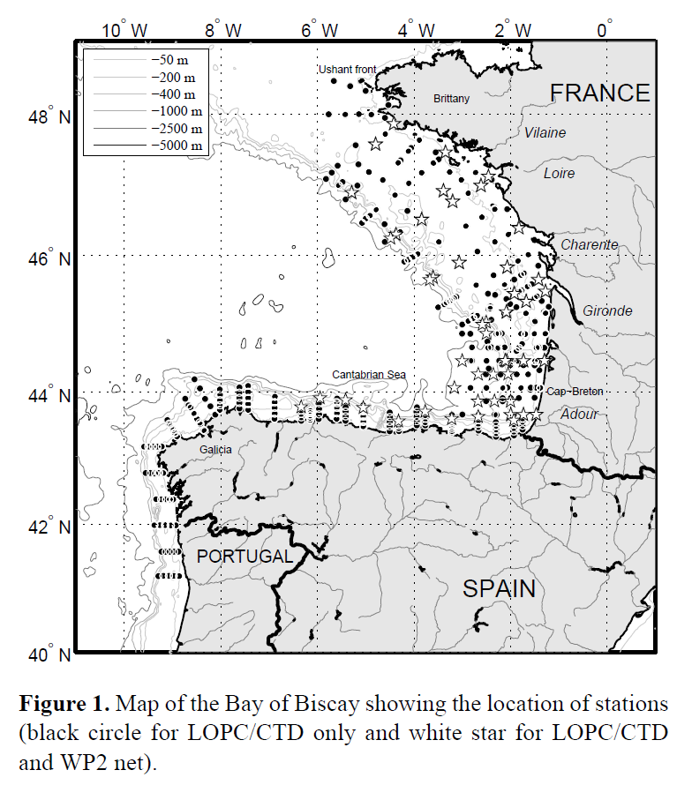
Vandromme 2014 summary
LOPC attached to CTD Rosette, sampled downward casts
Depth integrated samples
> 700 casts in spring (2005 – 2012) in Bay of Biscay
Large focus on comparing LOPC to net samples

Slide 3
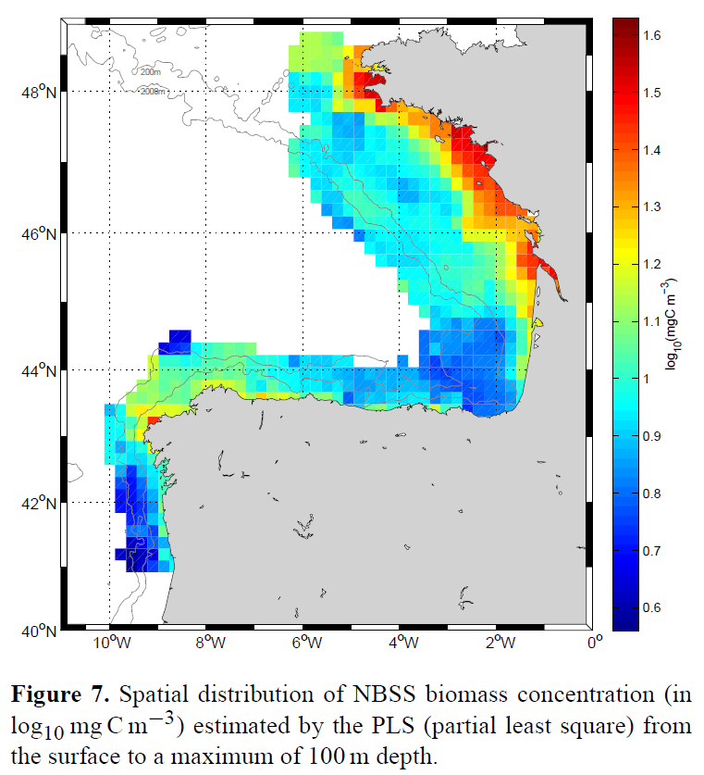
Vandromme 2014 summary
Biomass has strong spatial patterns
High in NE coastal area, low in SE coastal area
Onshore-Offshore gradient

Slide 4
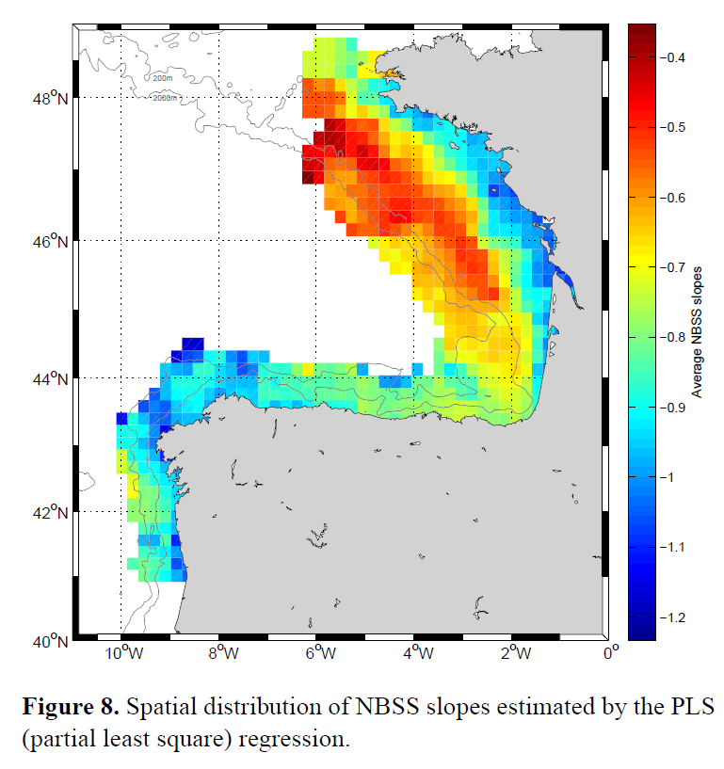
Vandromme 2014 summary
NBSS shows similar spatial patterns to Biomass
Steep slope in NE with offshore gradient to very shallow
Less of a gradient in SE

Slide 5
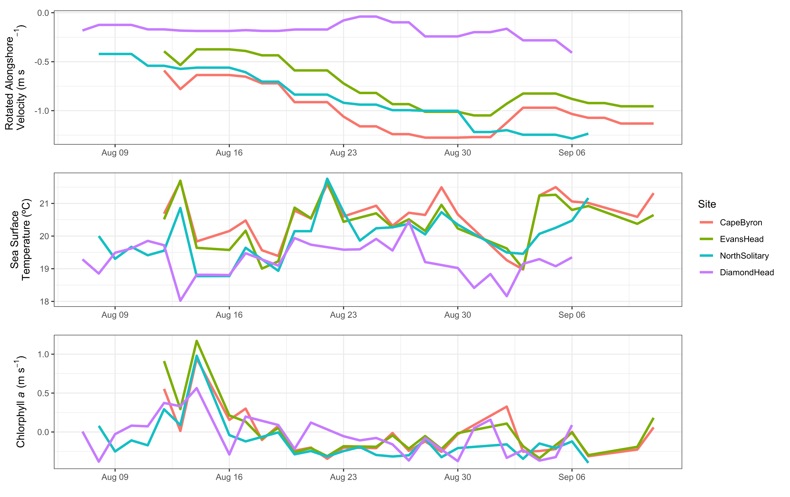
Diamond Head =
Low southward flow
Colder
Similar Chlorophyll a

Slide 6
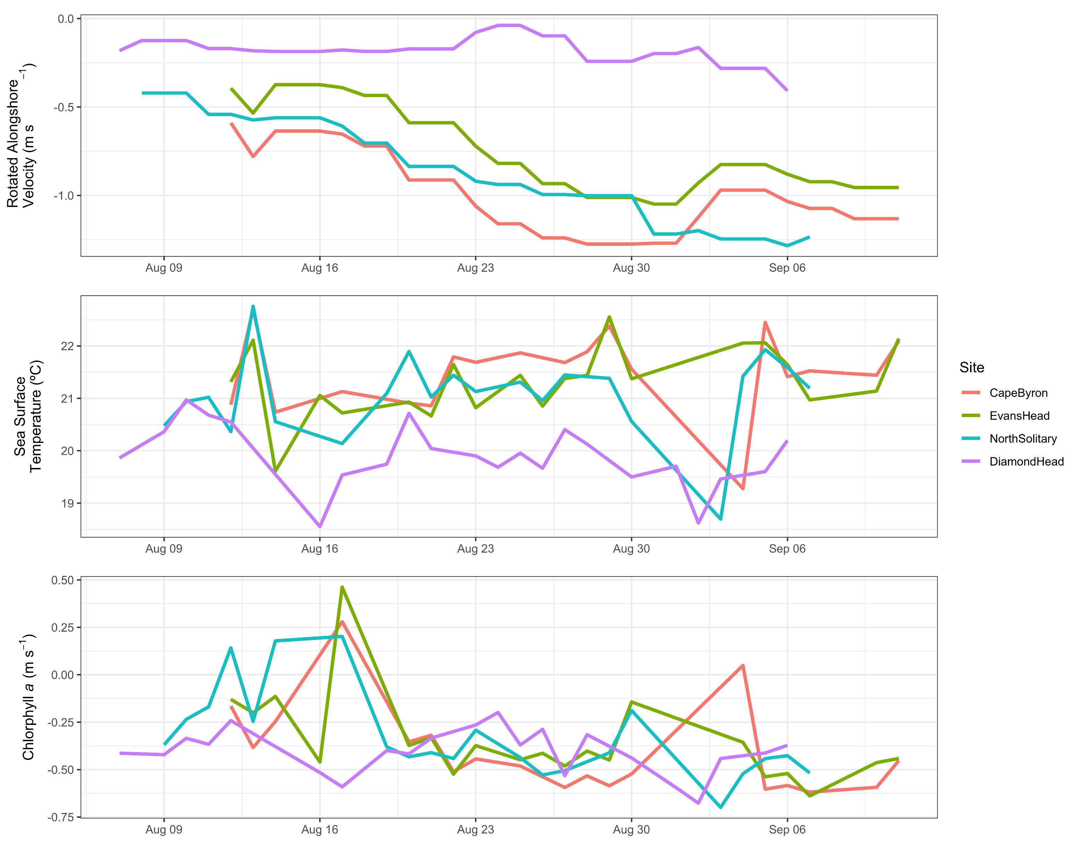
Smaller pixel size
More Chl-a variability
Cape Byron temp drops then back up before sampling
Corresponding changes in velocity and chl-a

Slide 7
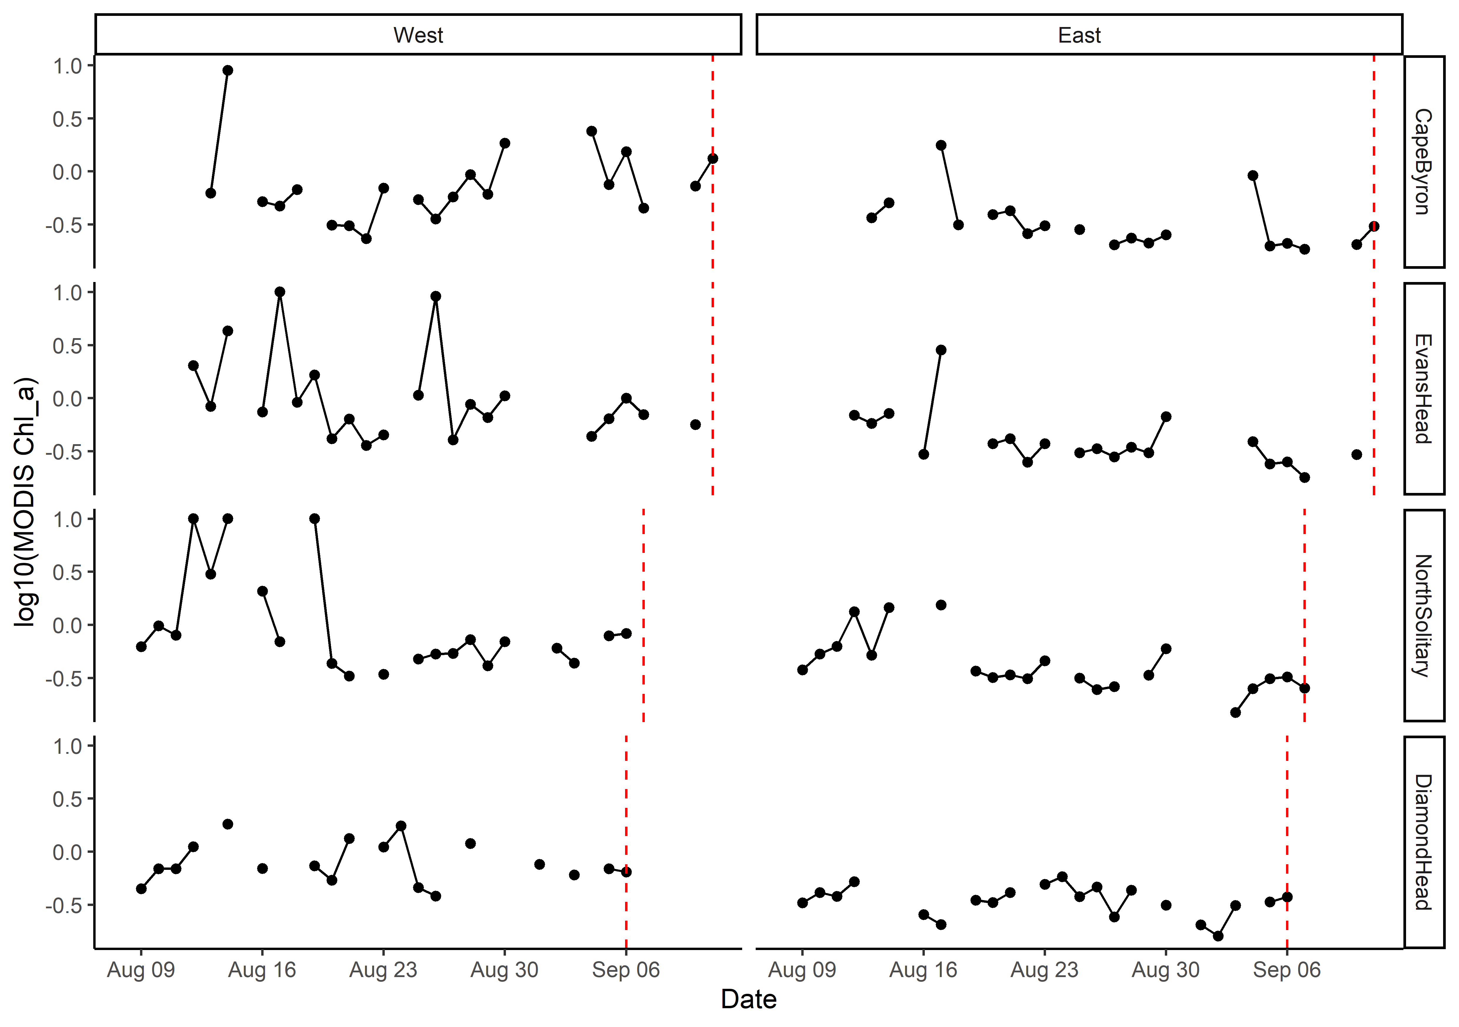
MODIS Chlorophyll a with gaps
Values >10 rescaled to be = 10
Log₁₀ transformed

Slide 8
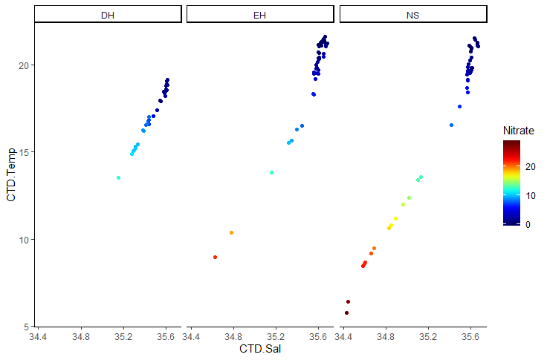
T-S Plot all depths (CTD)

Slide 9
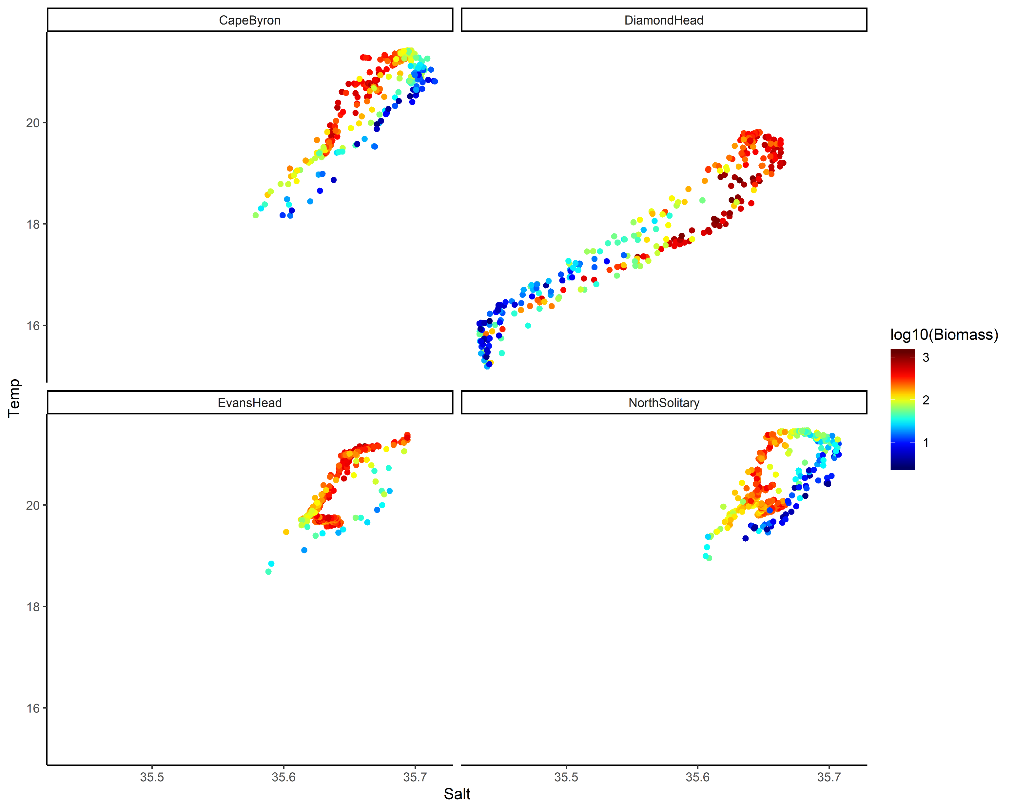
TS Plot by log₁₀(Biomass)

Slide 10
Key Questions
Aim: Describe the water and zooplankton characteristics across the East Australian shelf.
Water characteristics – physical oceanography
Zooplankton characteristics
Are they linked?
What is the larger context of these transects?

Slide 11
Water Characteristics
3 Transects go from inshore to EAC
Diamond Head is in a separation zone
See V-rotated velocities and Temperature
2 types of water mass, EAC influenced and separation zone
Compare northern 3 to Diamond Head

Slide 12
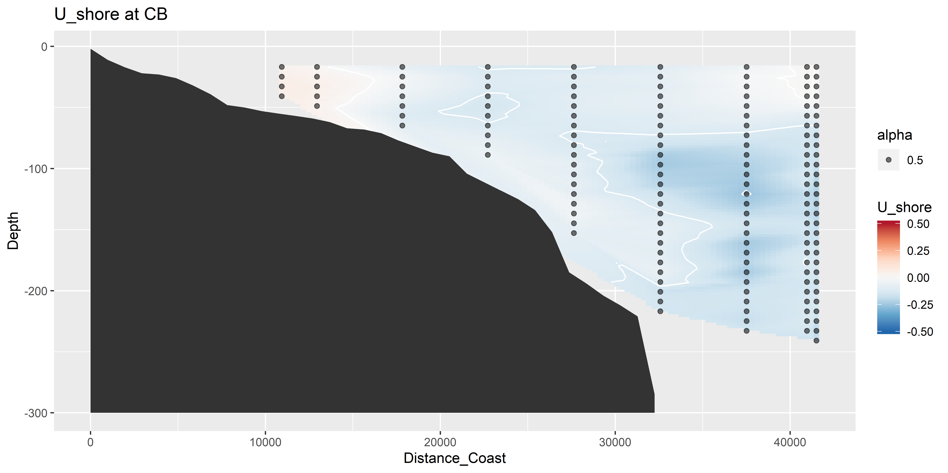
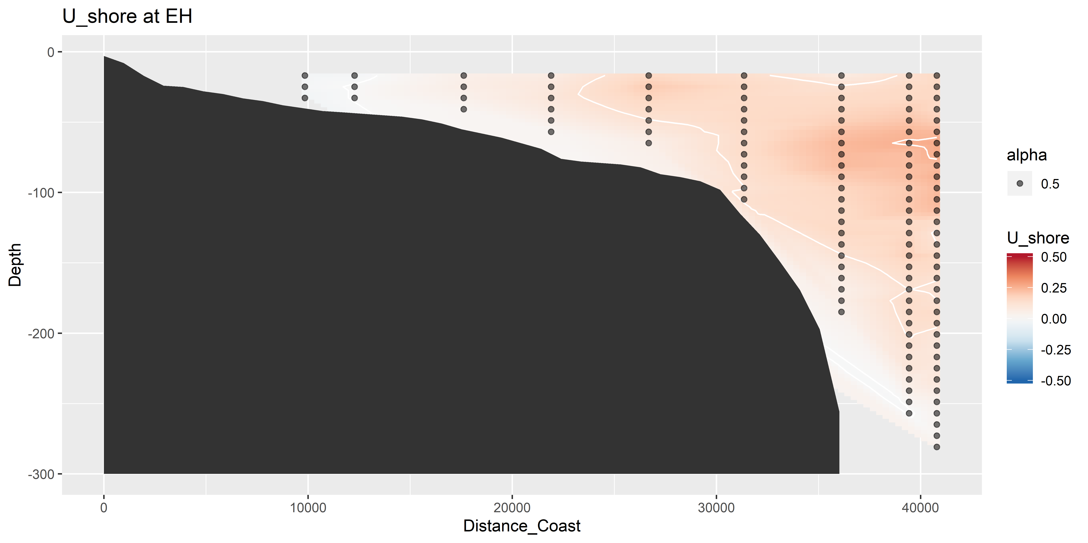
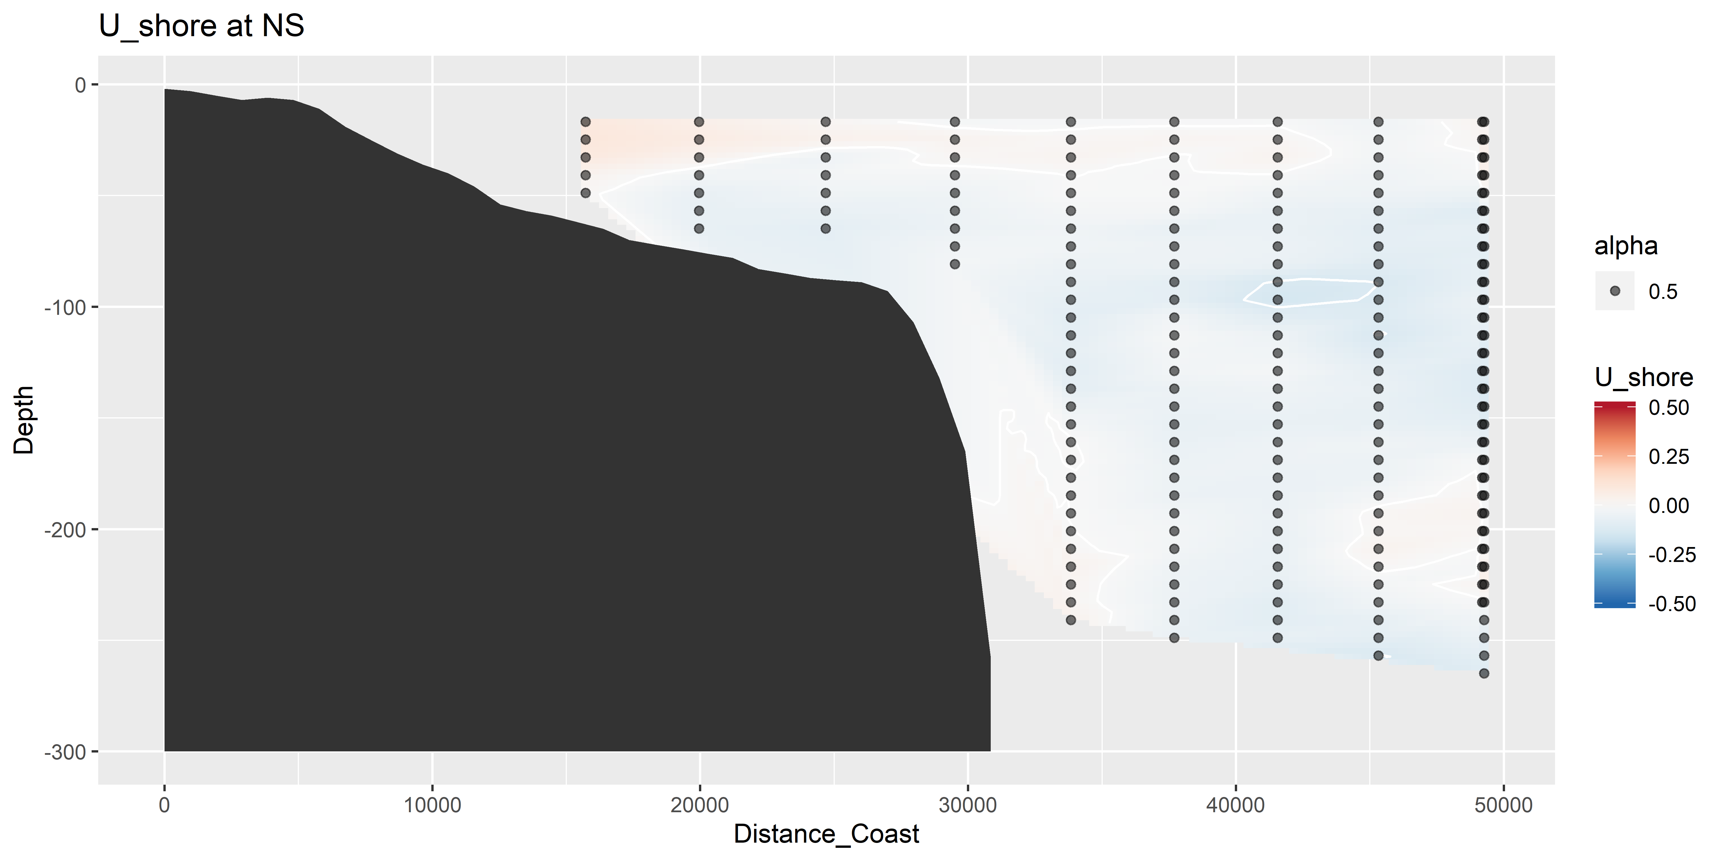
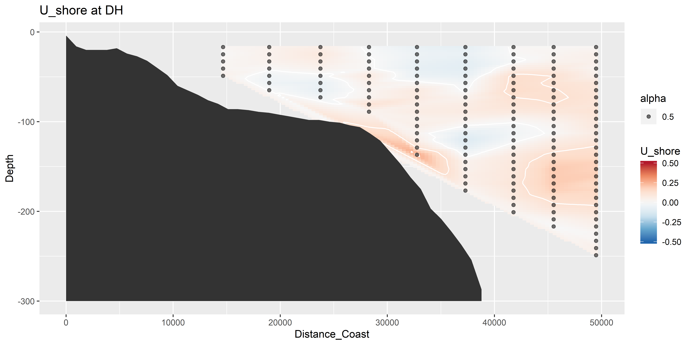
U vectors – shoreline rotated (m s⁻¹)

Slide 13
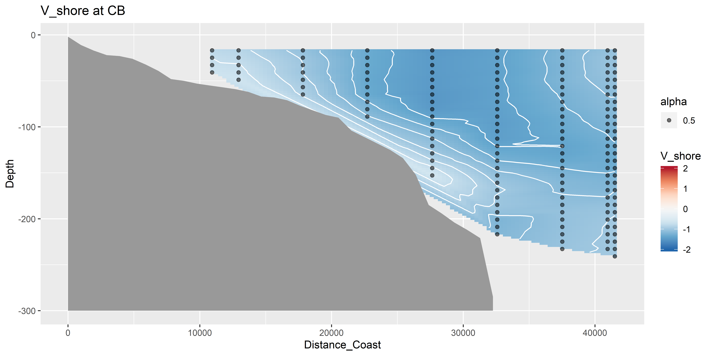
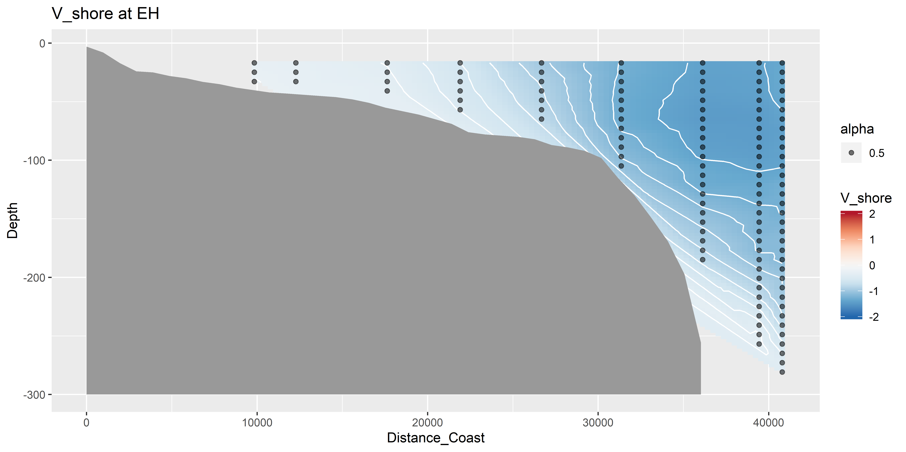
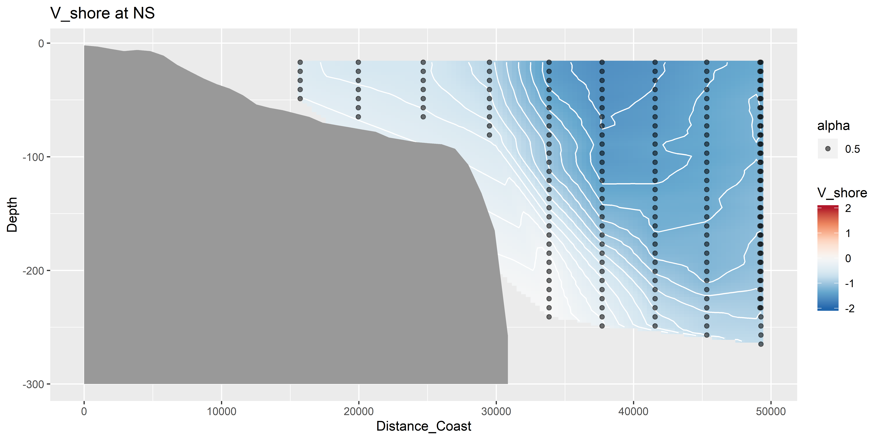
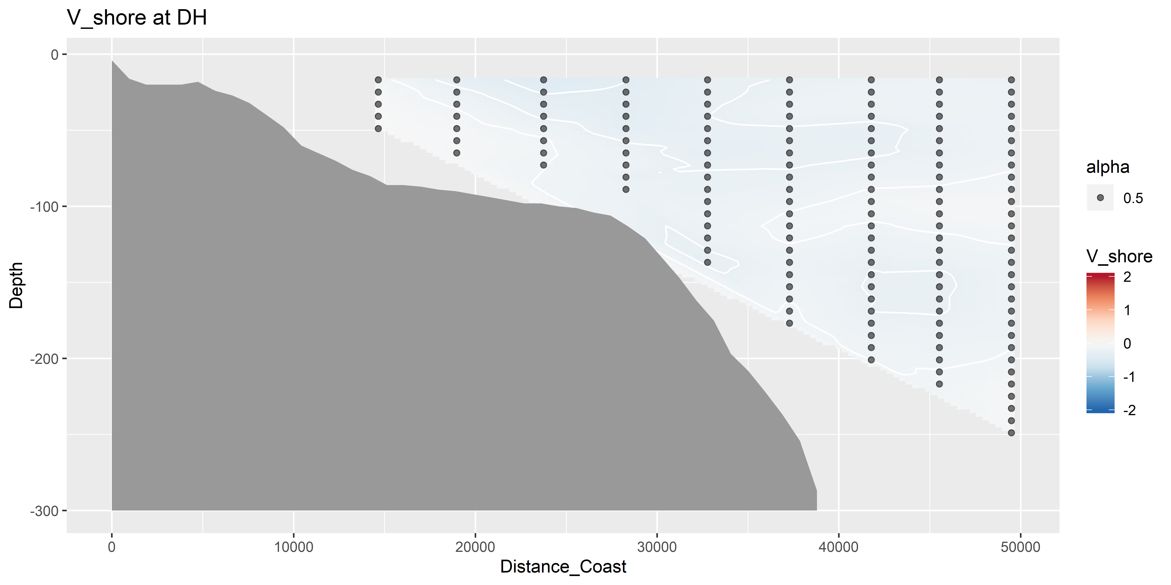
V vectors – shoreline rotated (m s⁻¹)

Slide 14
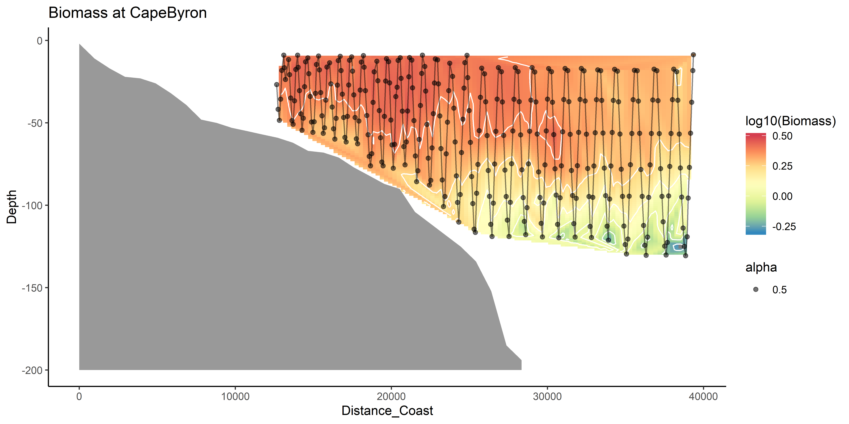
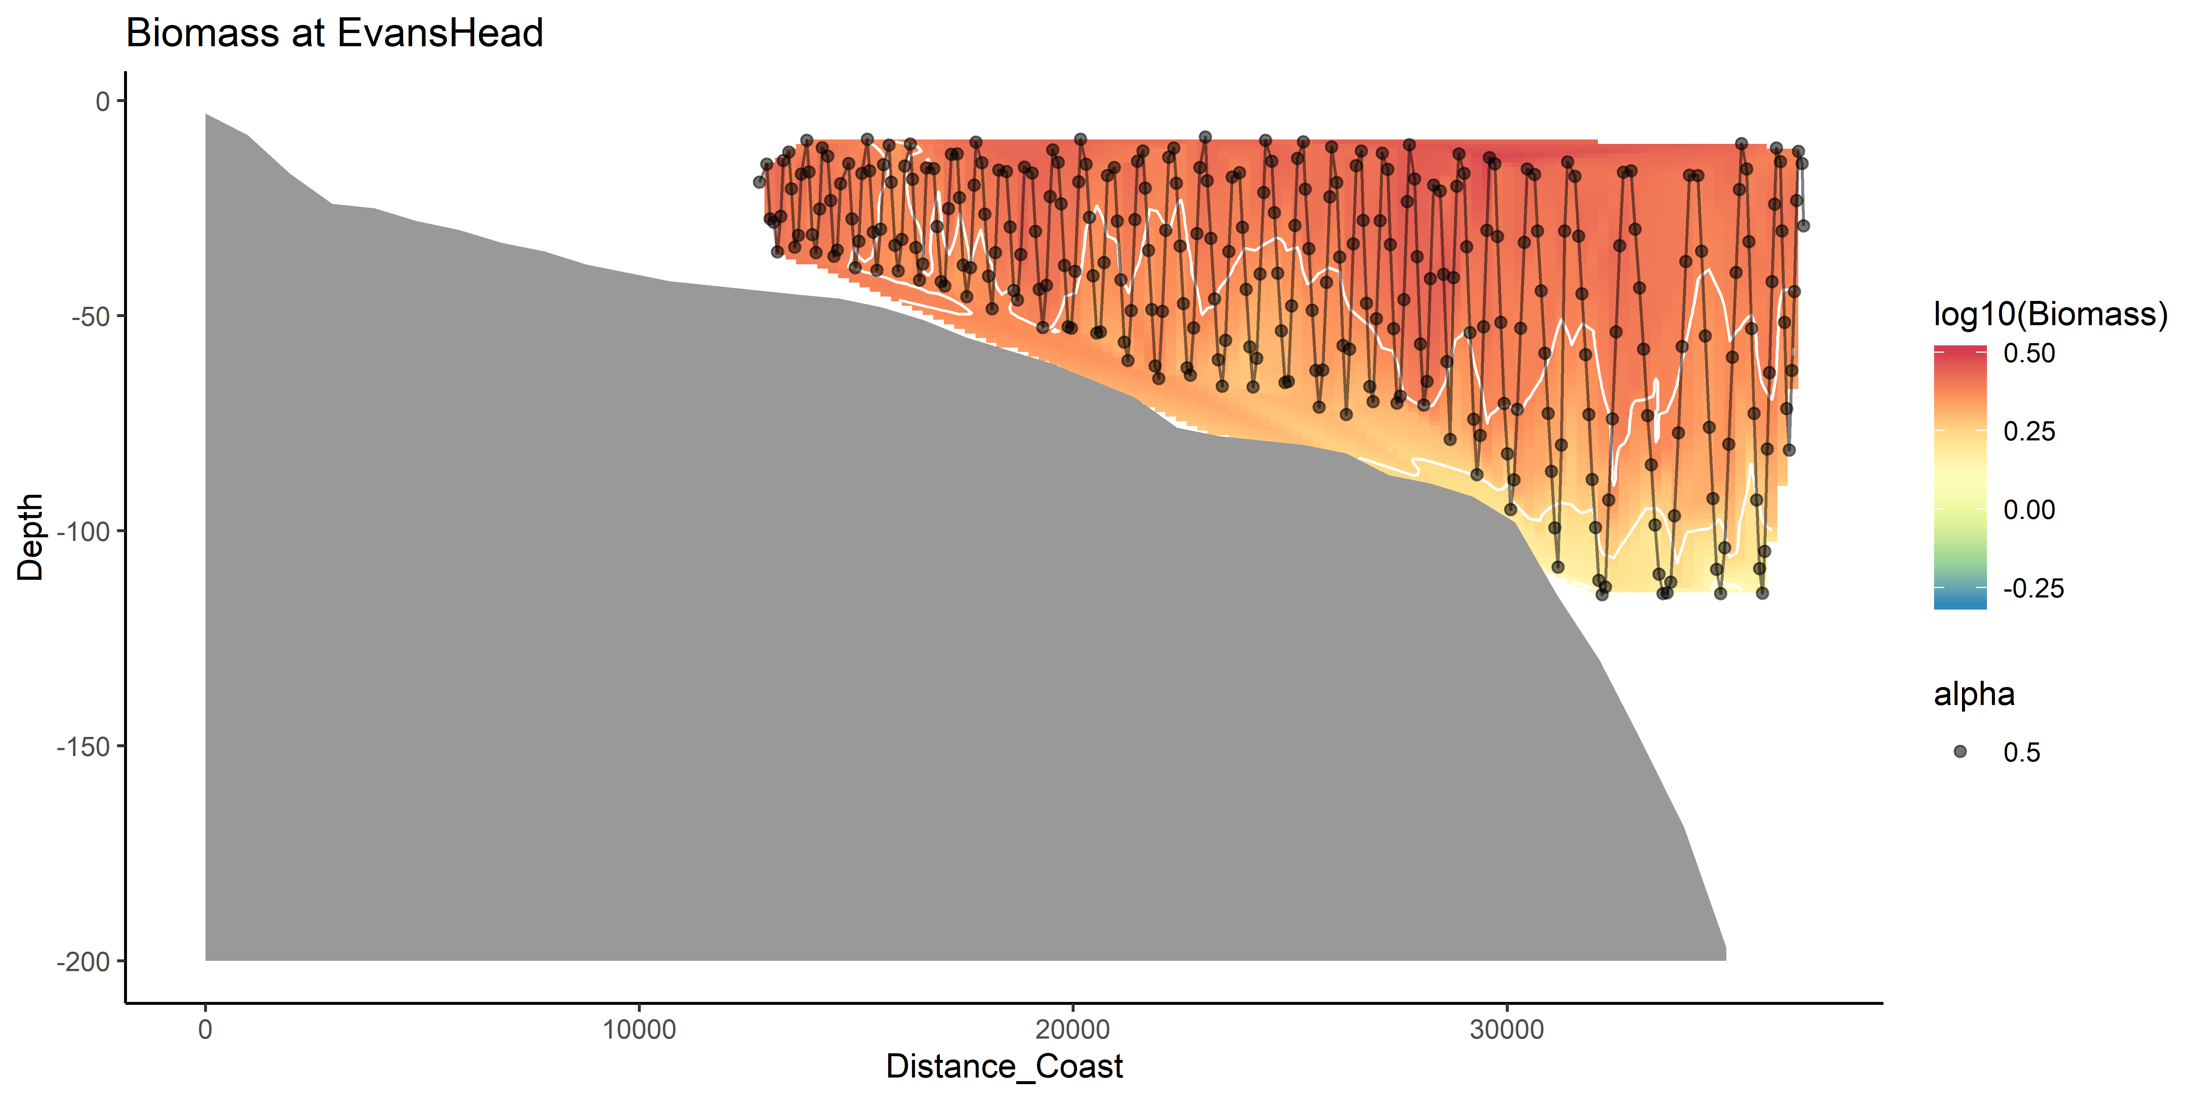
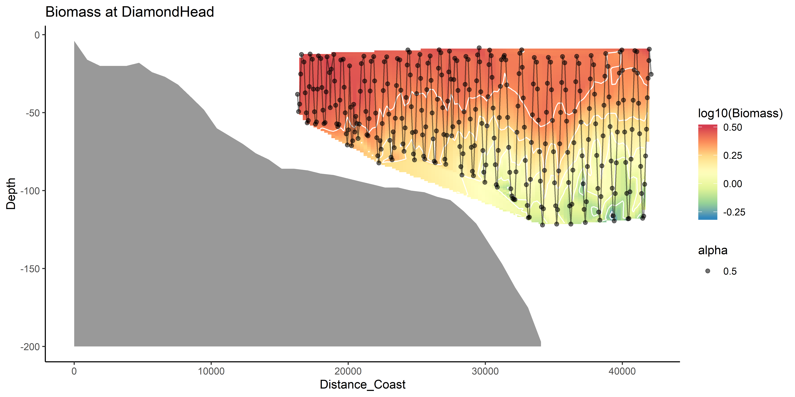
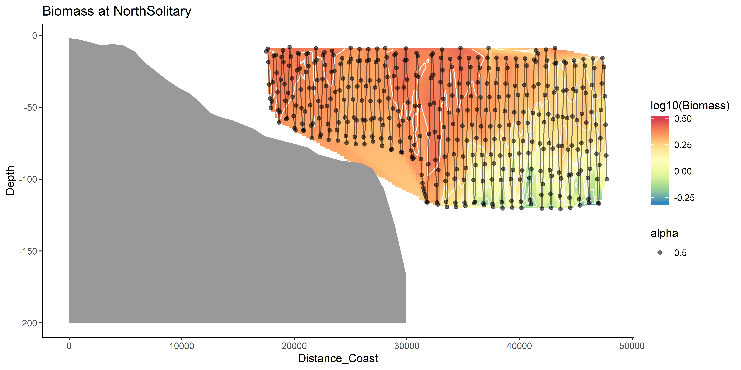
Zooplankton Biomass

Slide 15
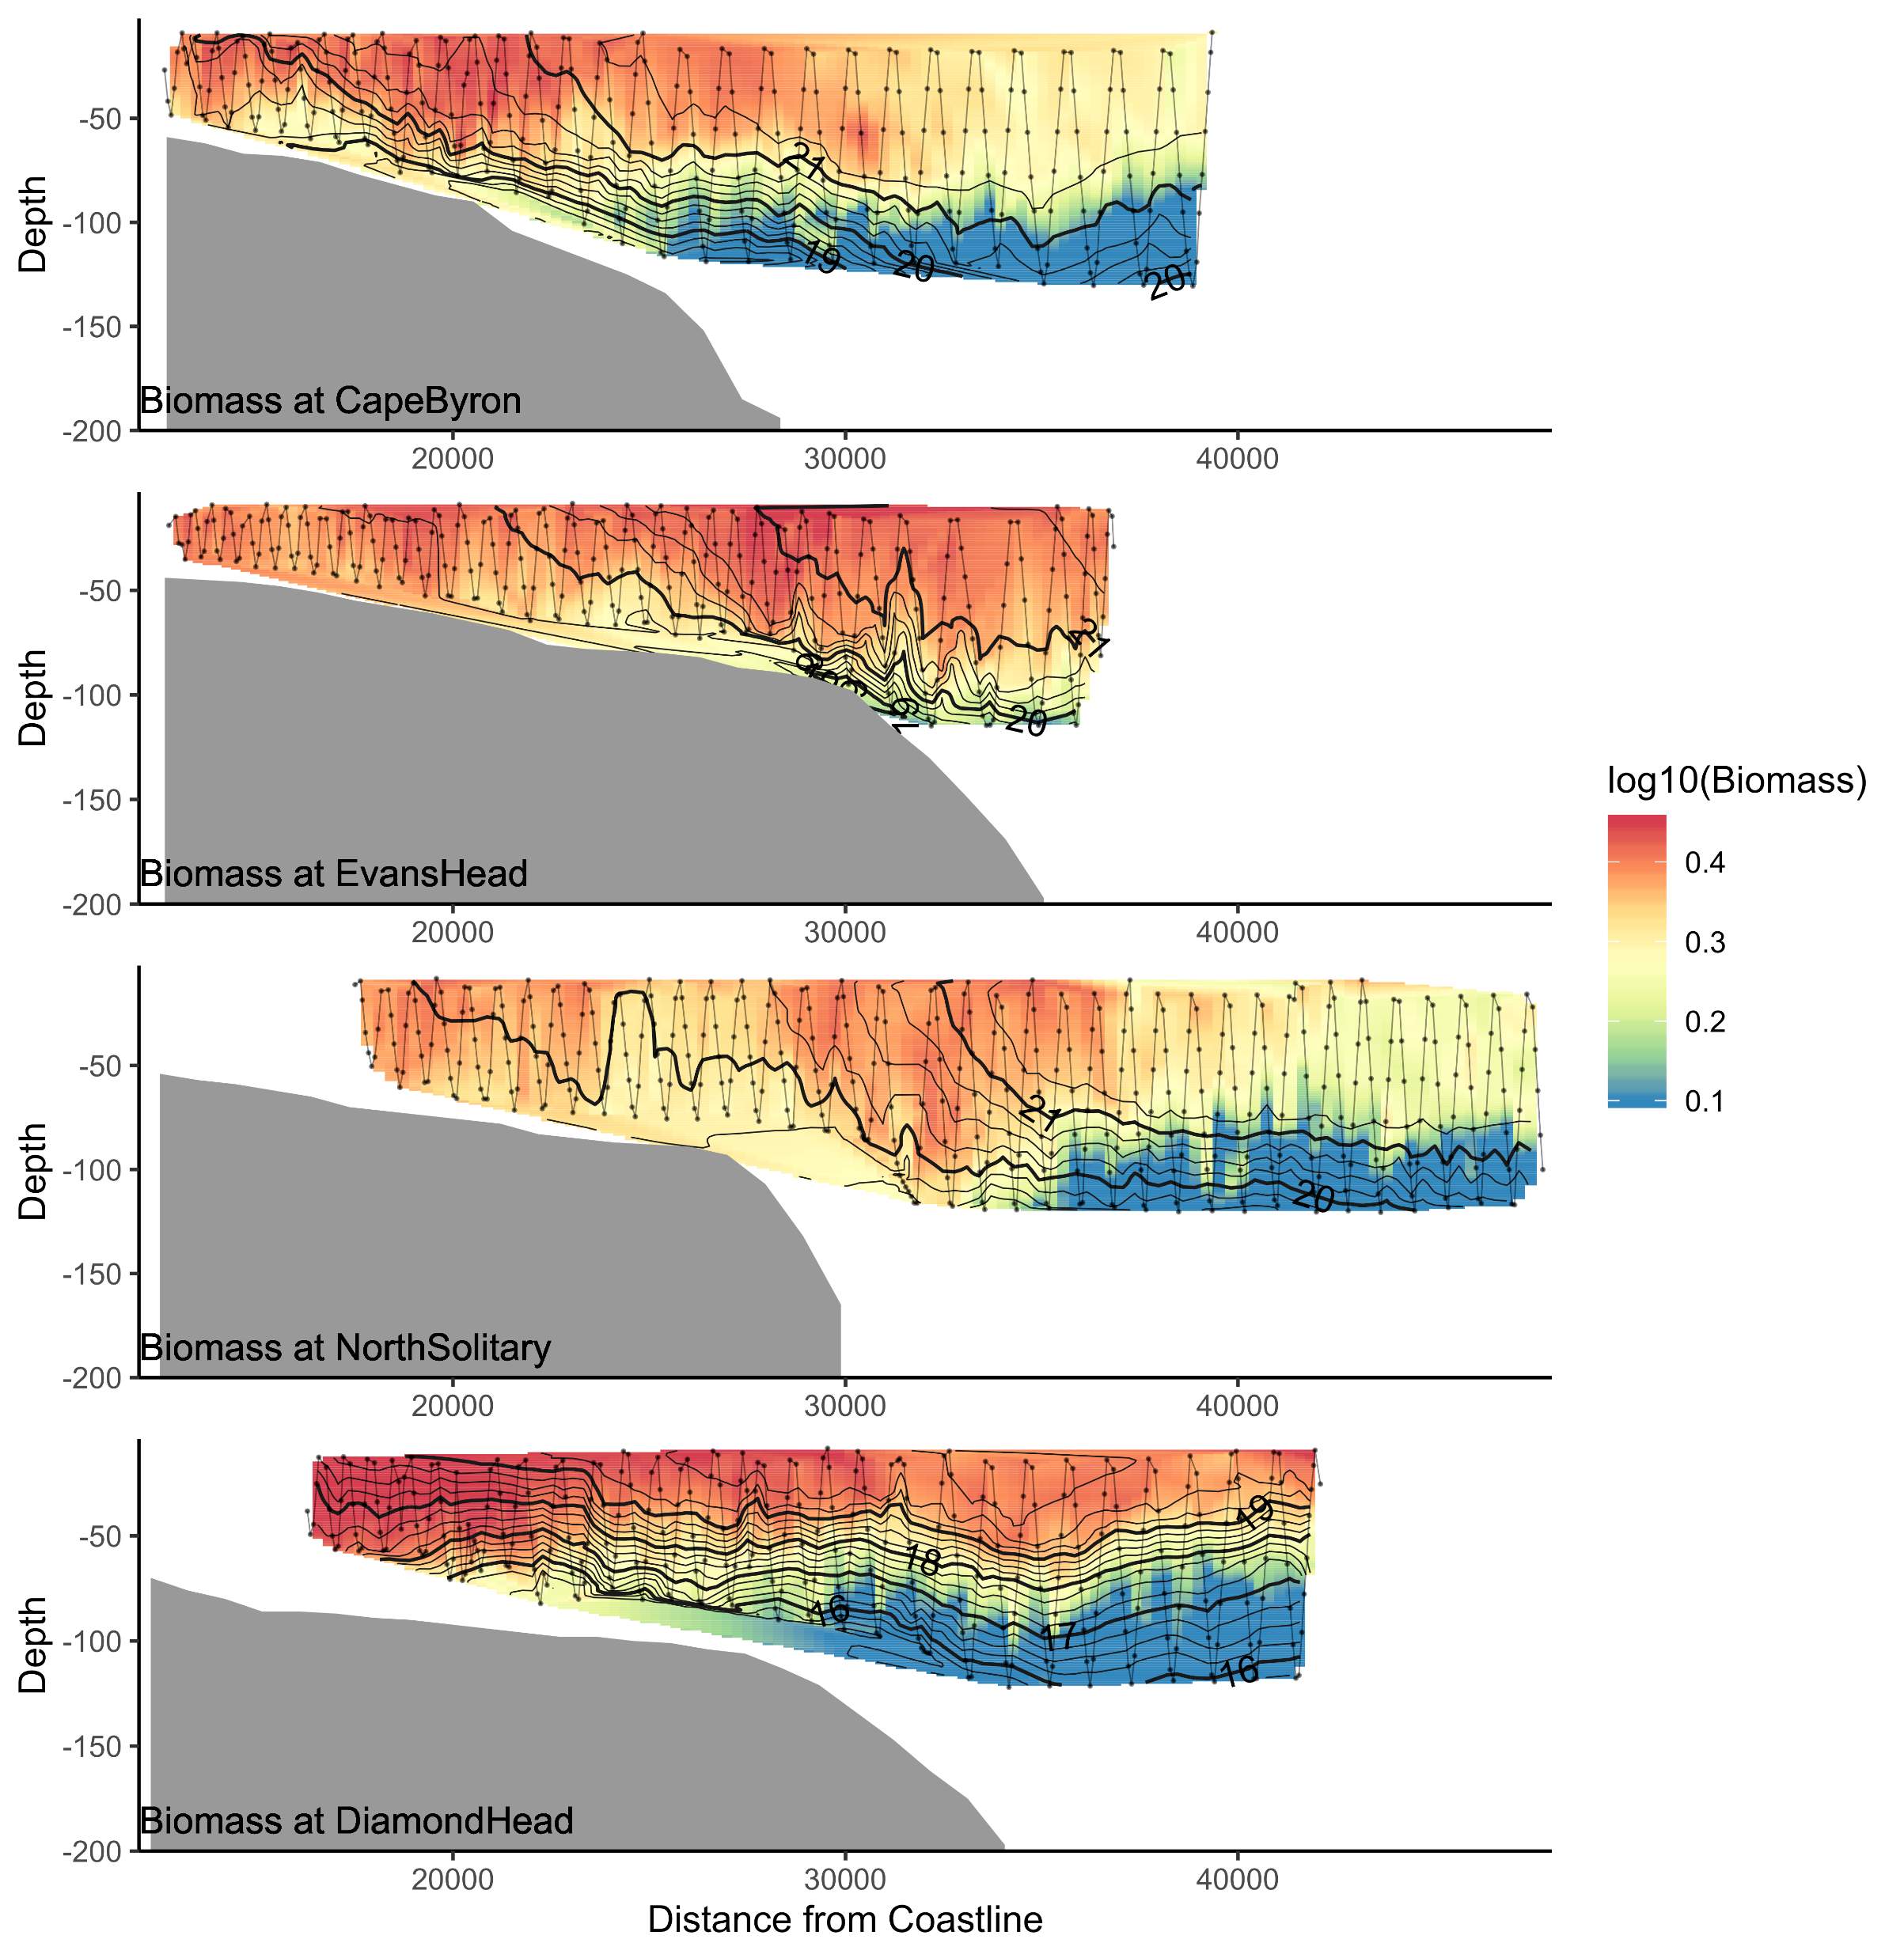
Biomass

Slide 16
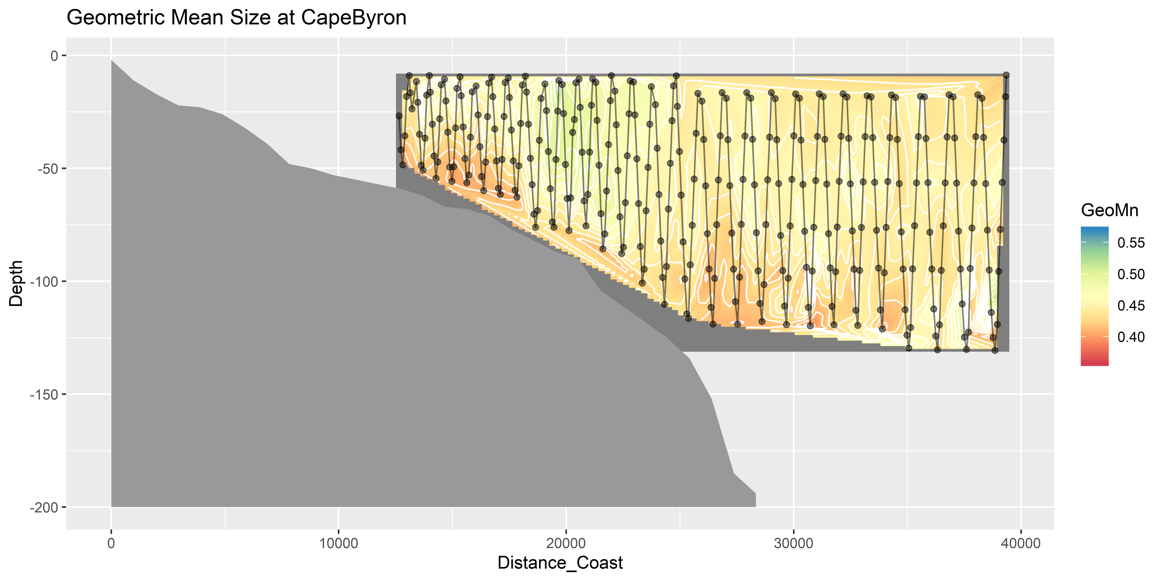
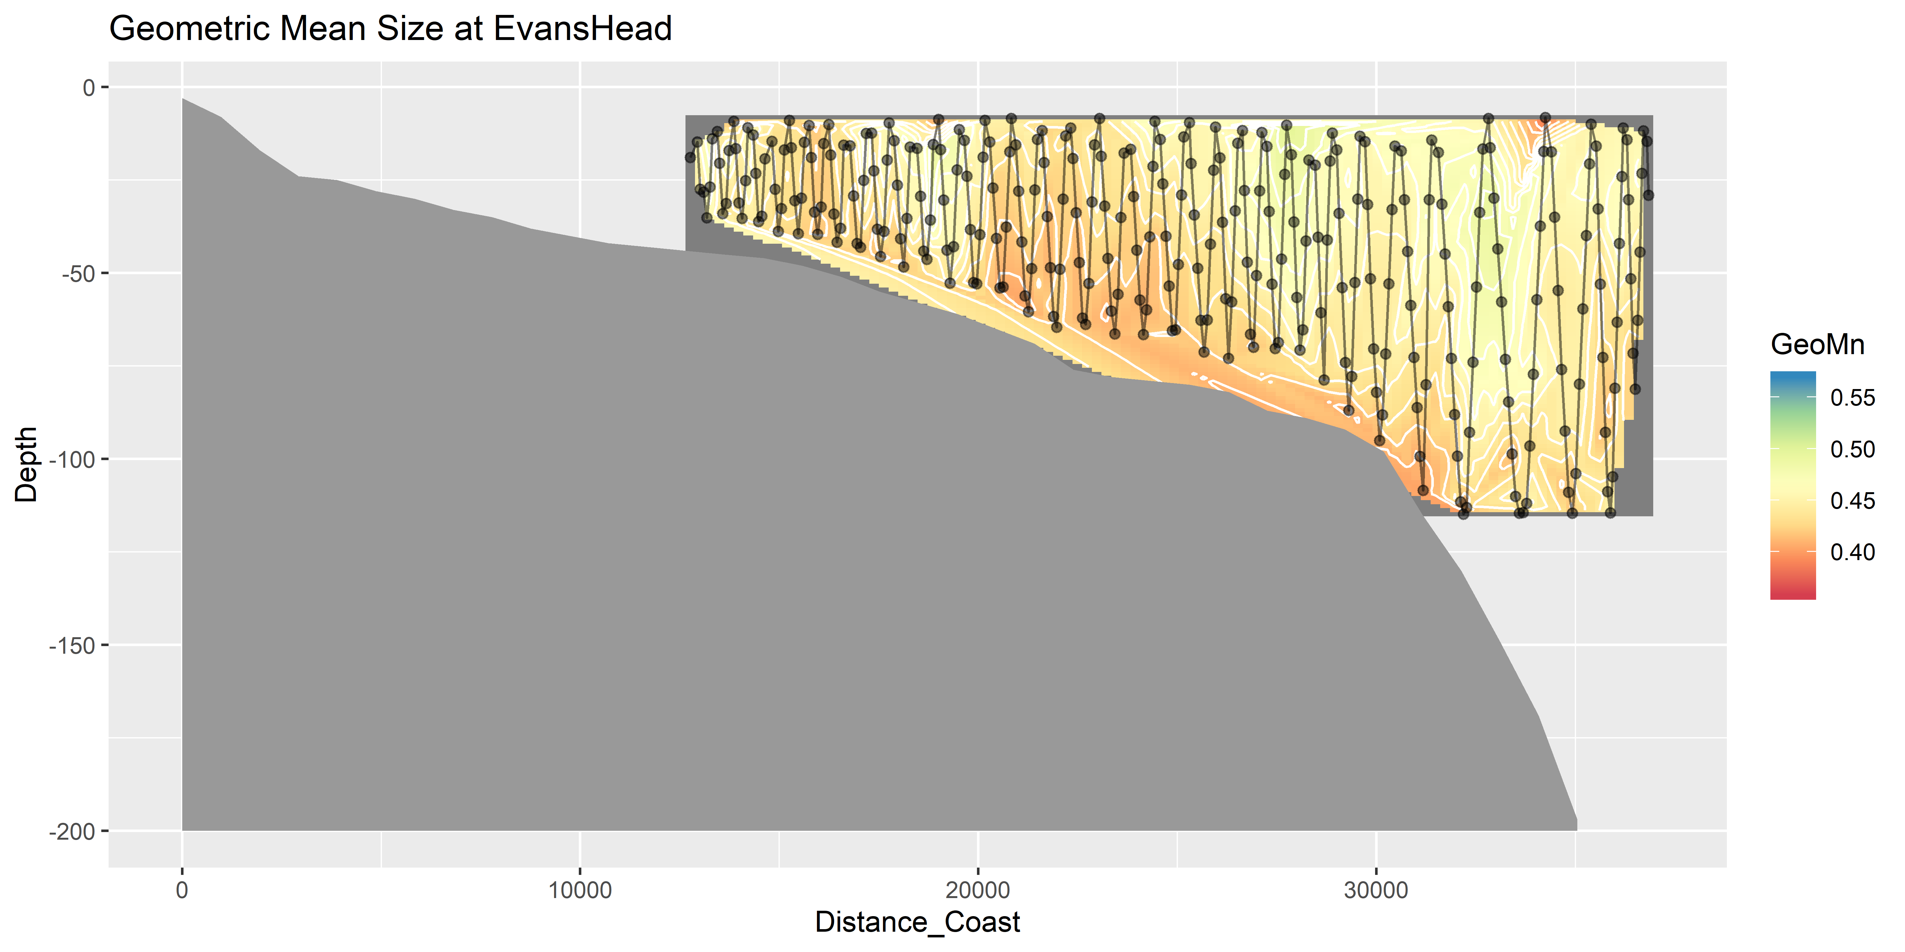
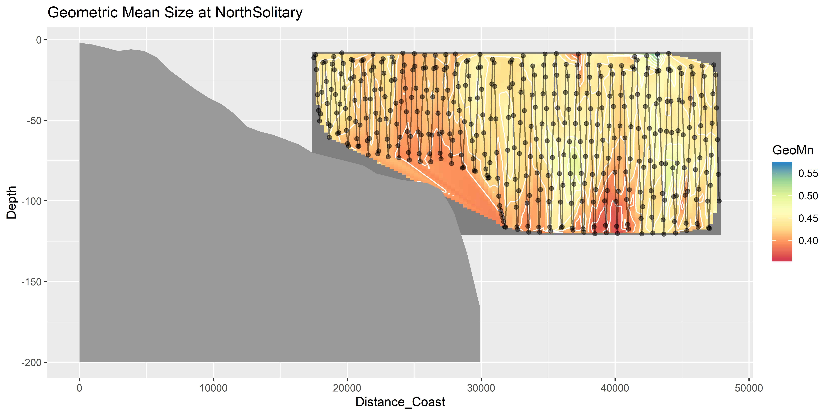
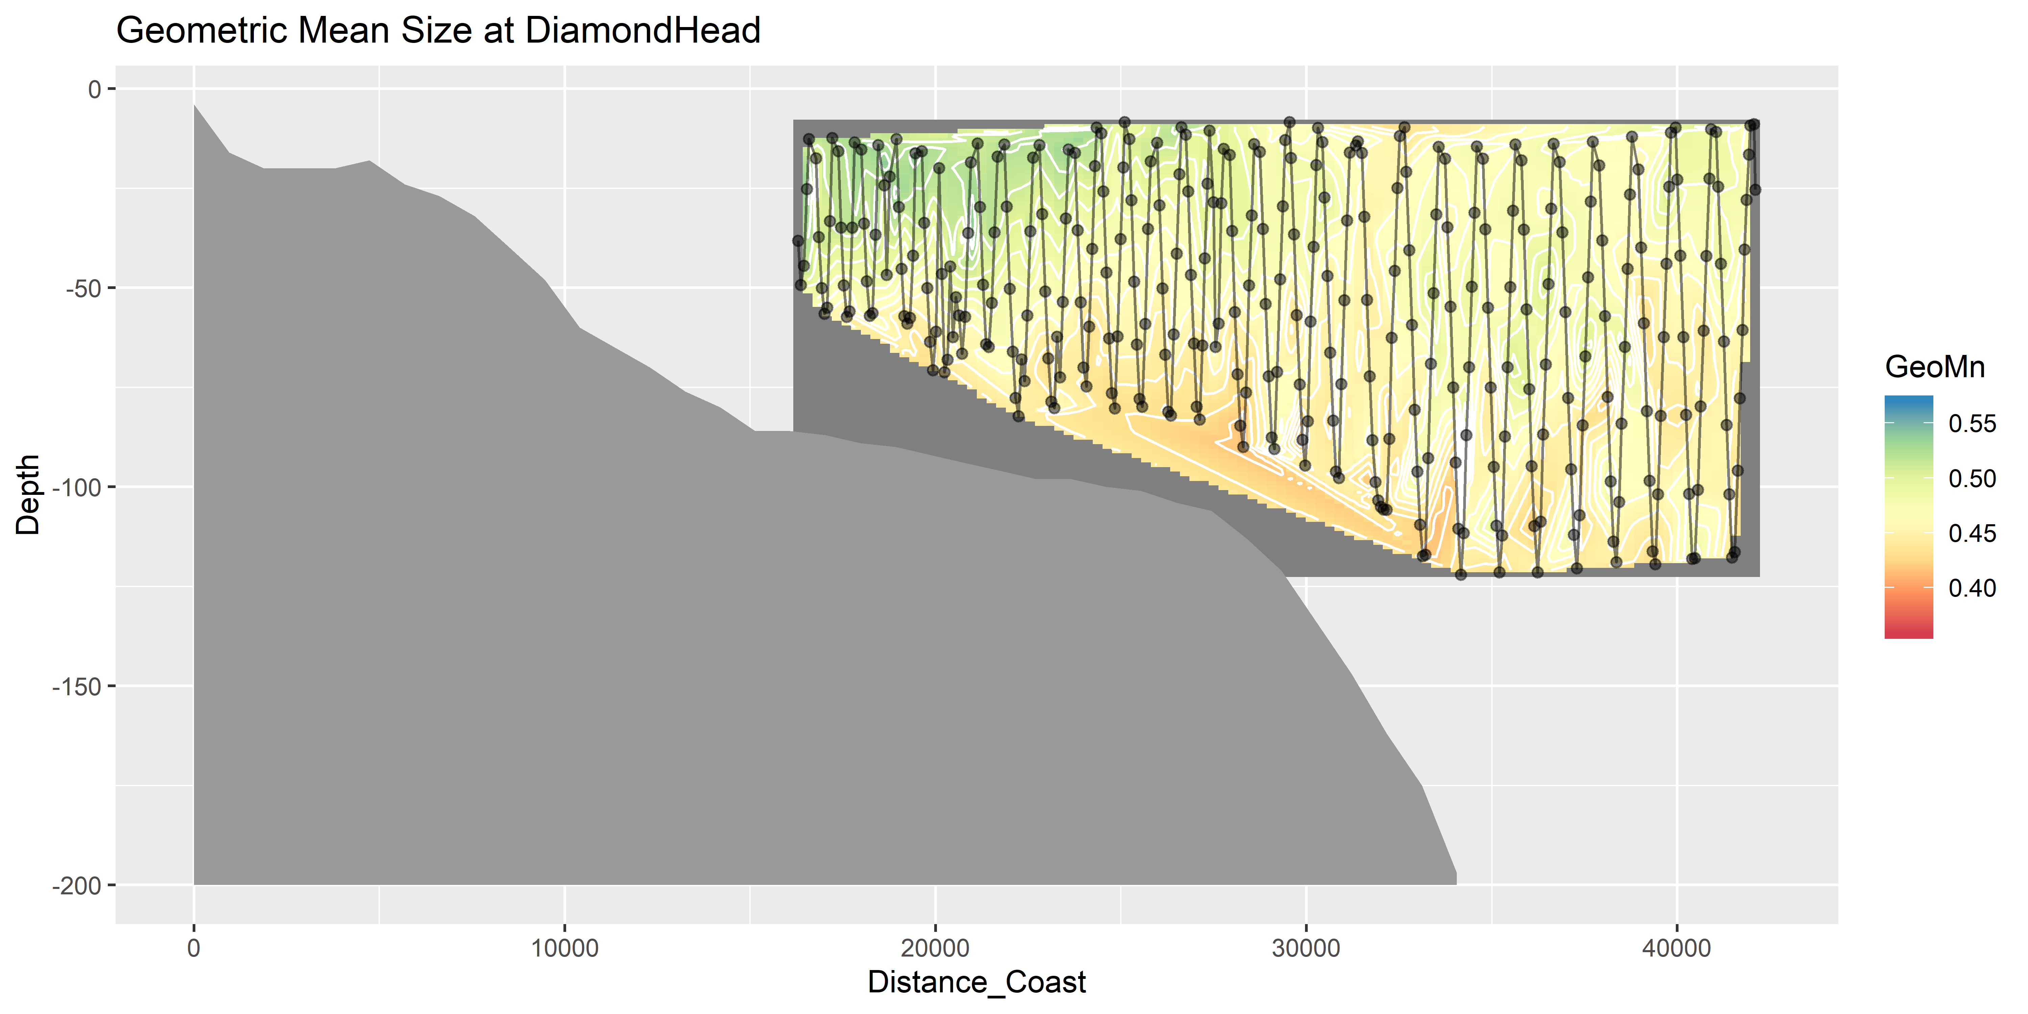
Geometric Mean Size

Slide 17
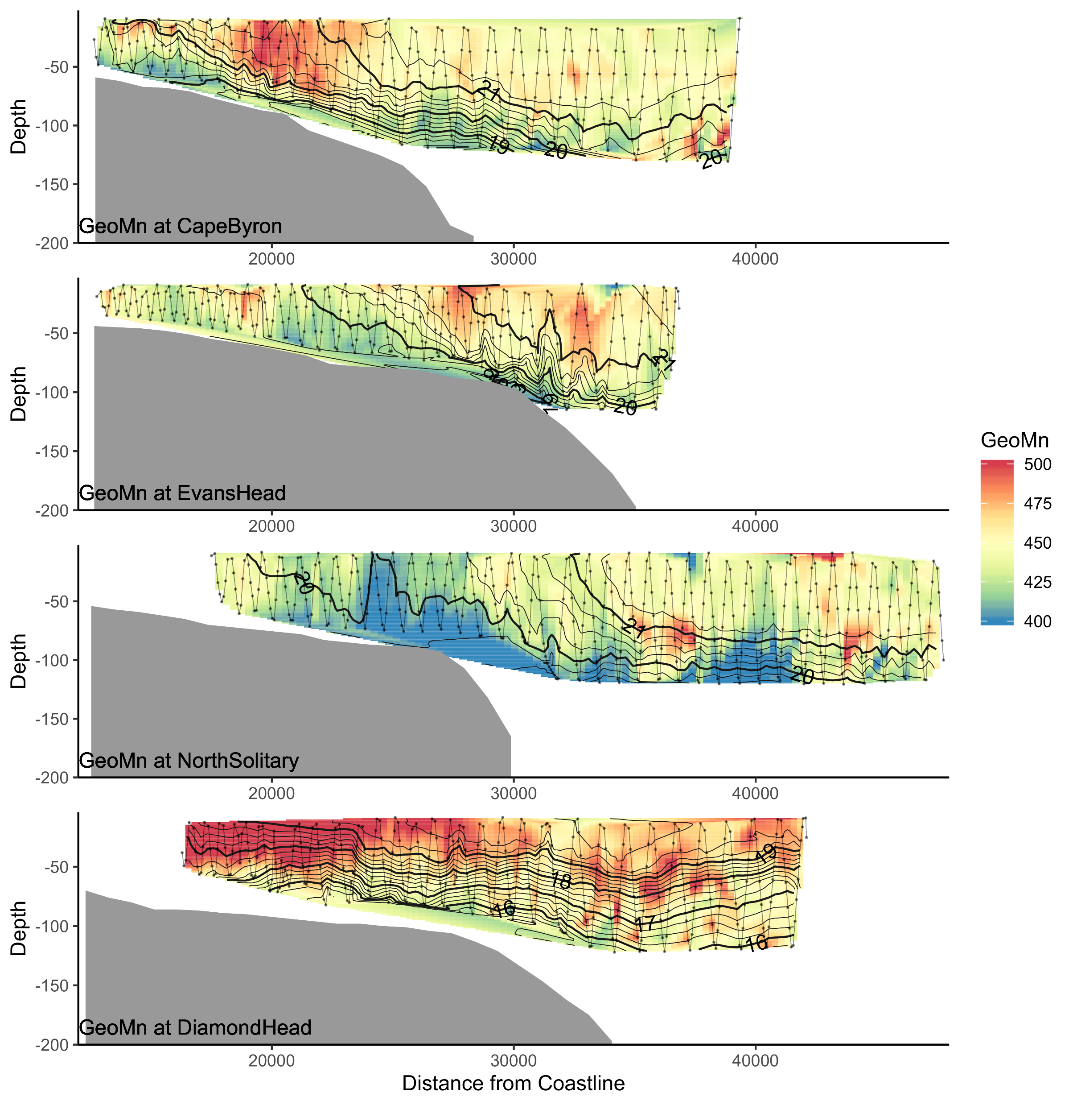
Geo Mean Size

Slide 18
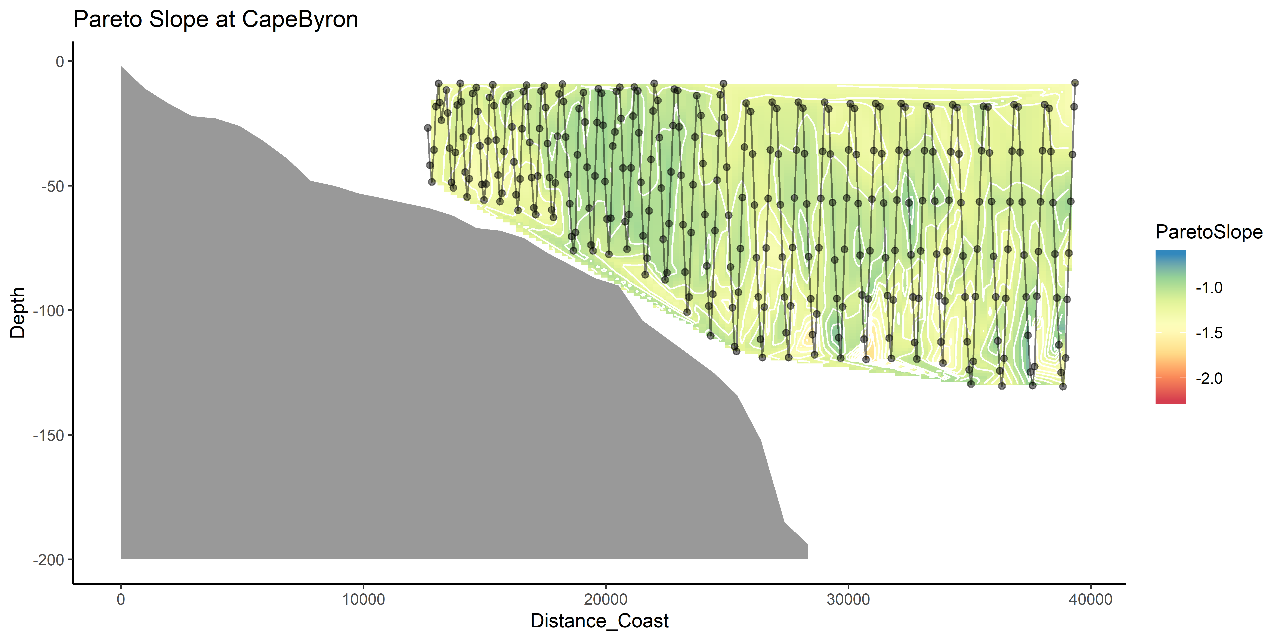
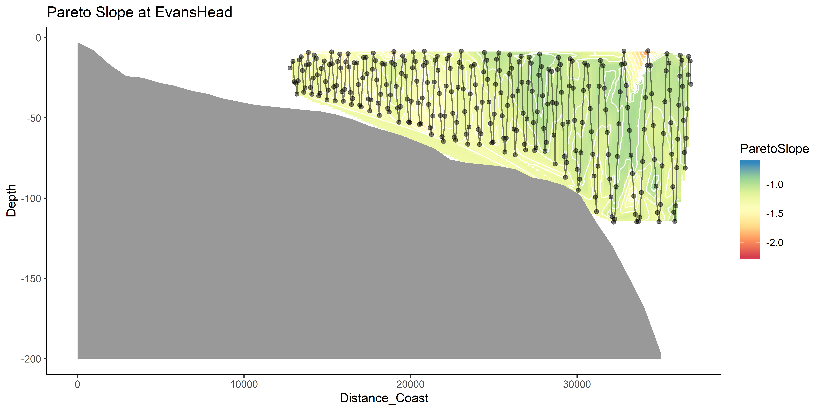
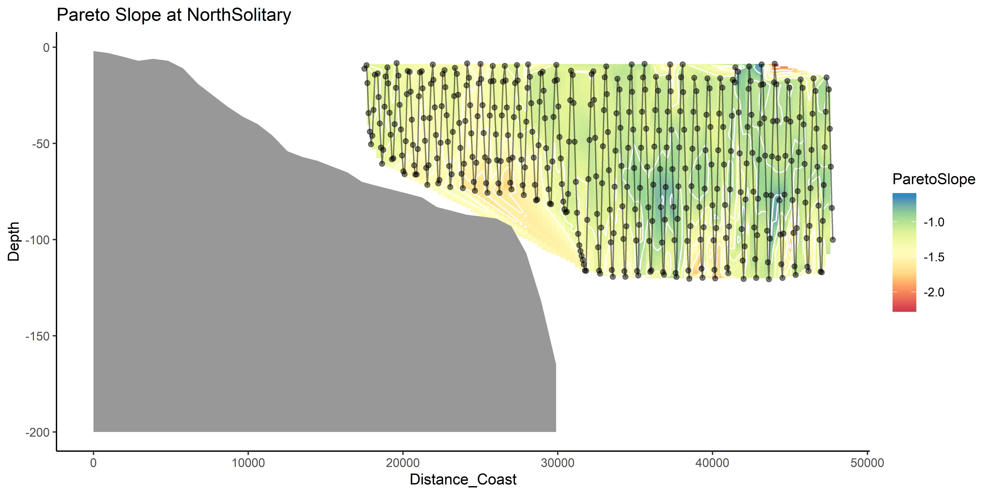
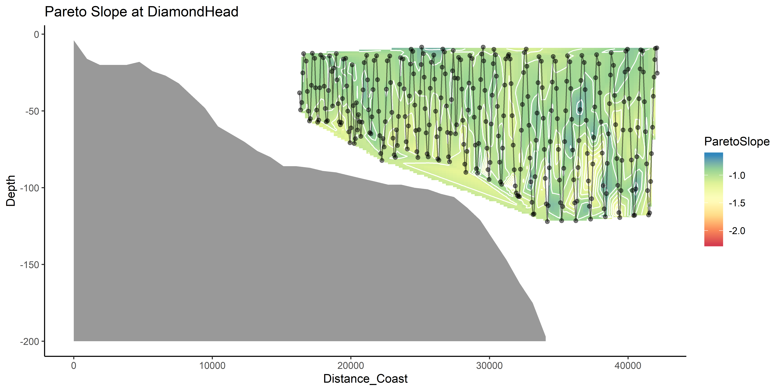
Pareto Slope

Slide 19
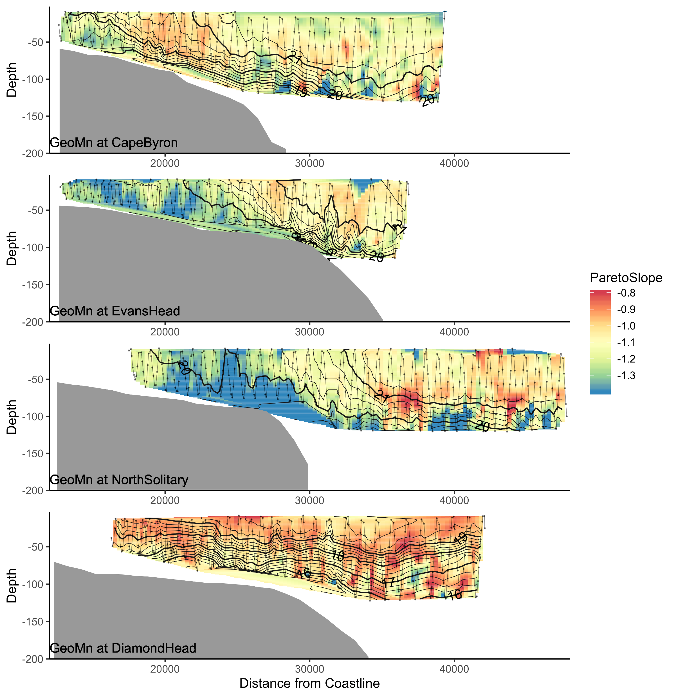
Pareto Slope

Slide 20
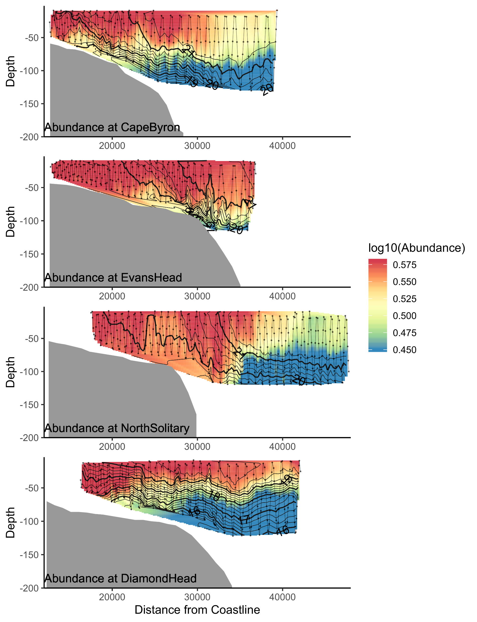
Abundance

Slide 21
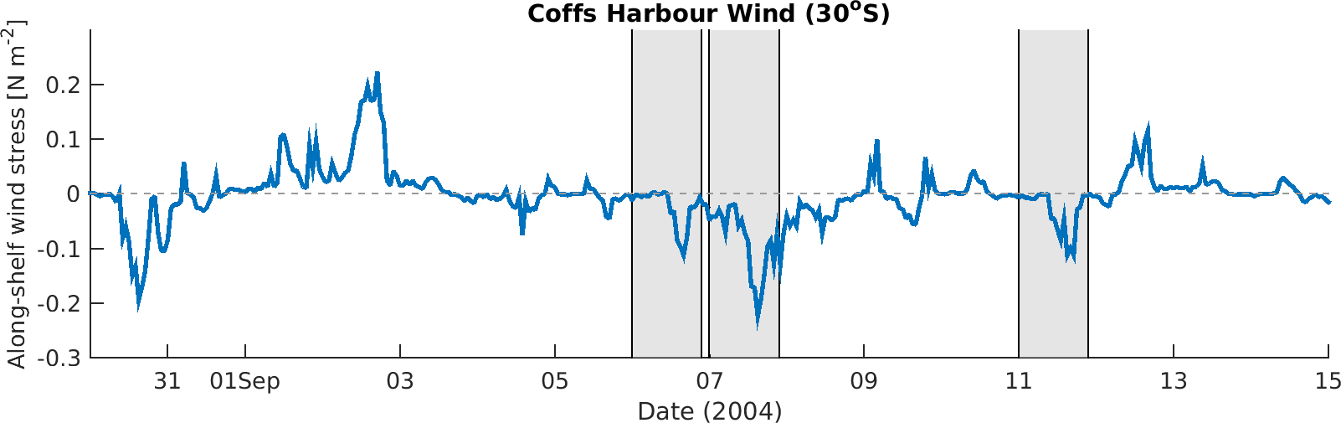
Wind Stress
DH
EH
CB

Slide 22
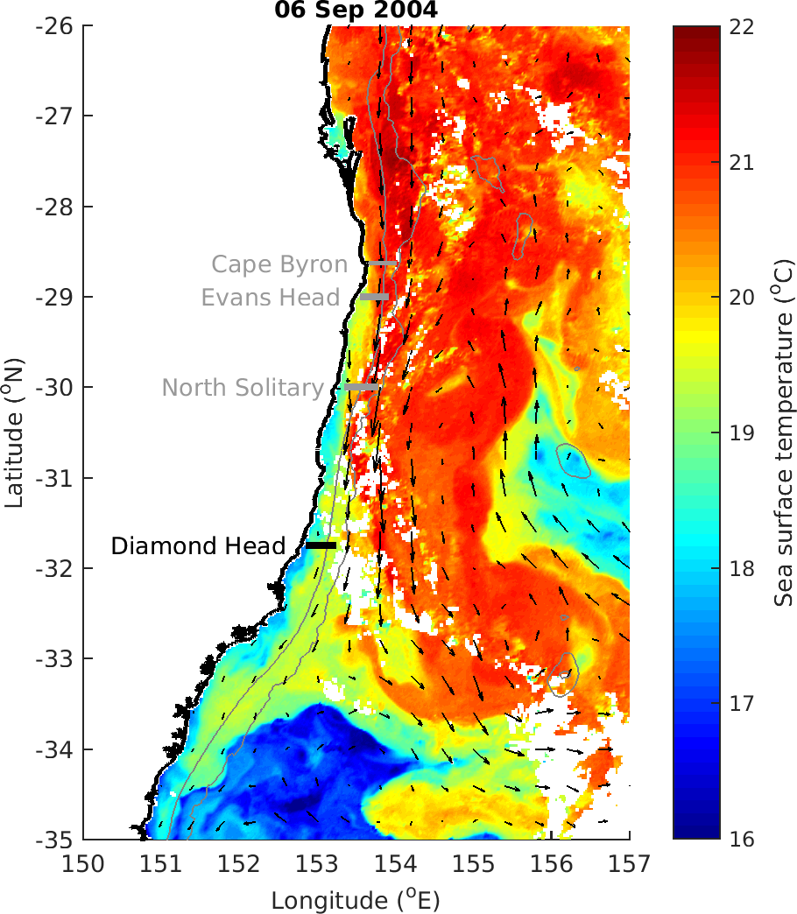

Slide 23
Zooplankton Characteristics
Biomass decreases with depth and distance from shore
Does size vary between the EAC water masses and separation zone?
Largest particles near shore at Diamond Head, due to separation and different water?
Slope does not appear to consistently approach -1 in offshore water (theoretical expectation)
Vandromme showed shallower slope offshore (-1 → -0.4; SW France)

Slide 25
OLDER STUFF

Slide 26
Linking water and zooplankton
Temp + Salt highly correlated (0.93)
Temp + Depth slight neg. cor. (-0.3)
Temp + Distance_Coast slight pos. cor (0.24)
Longitude + Distance_Coast slight pos. cor (0.09)
Moran’s I value = 0.33 (Biomass)
Moran’s I value = 0.29 (Pareto Slope)

Slide 27
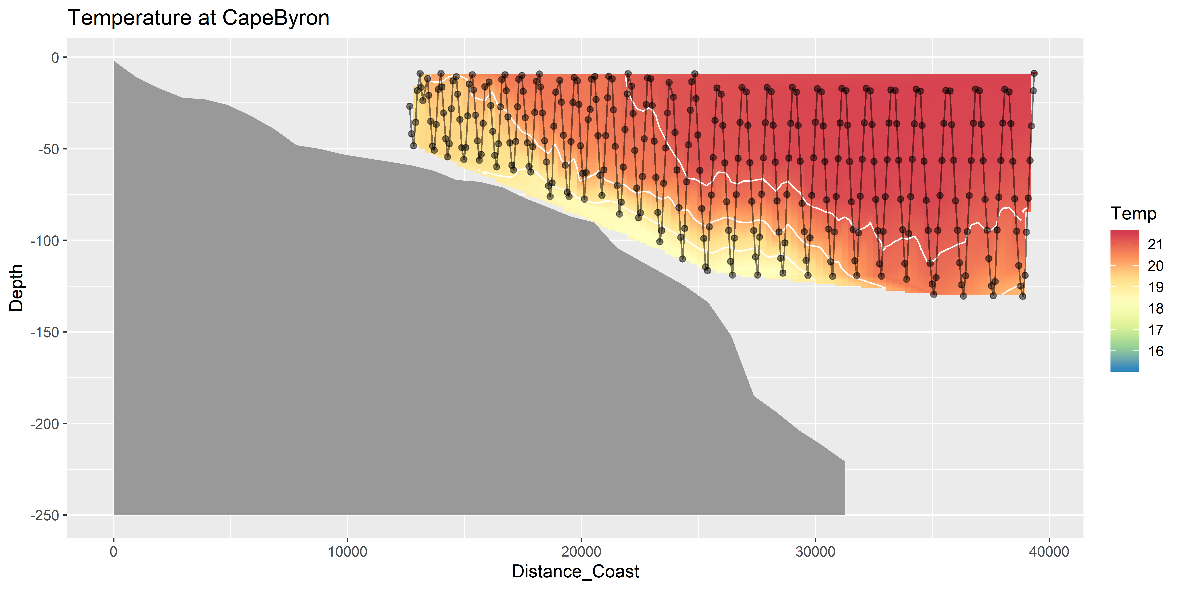
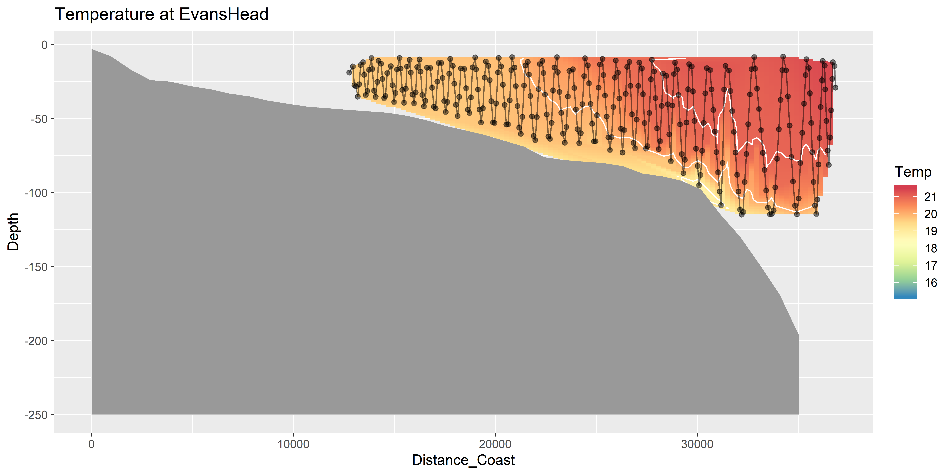
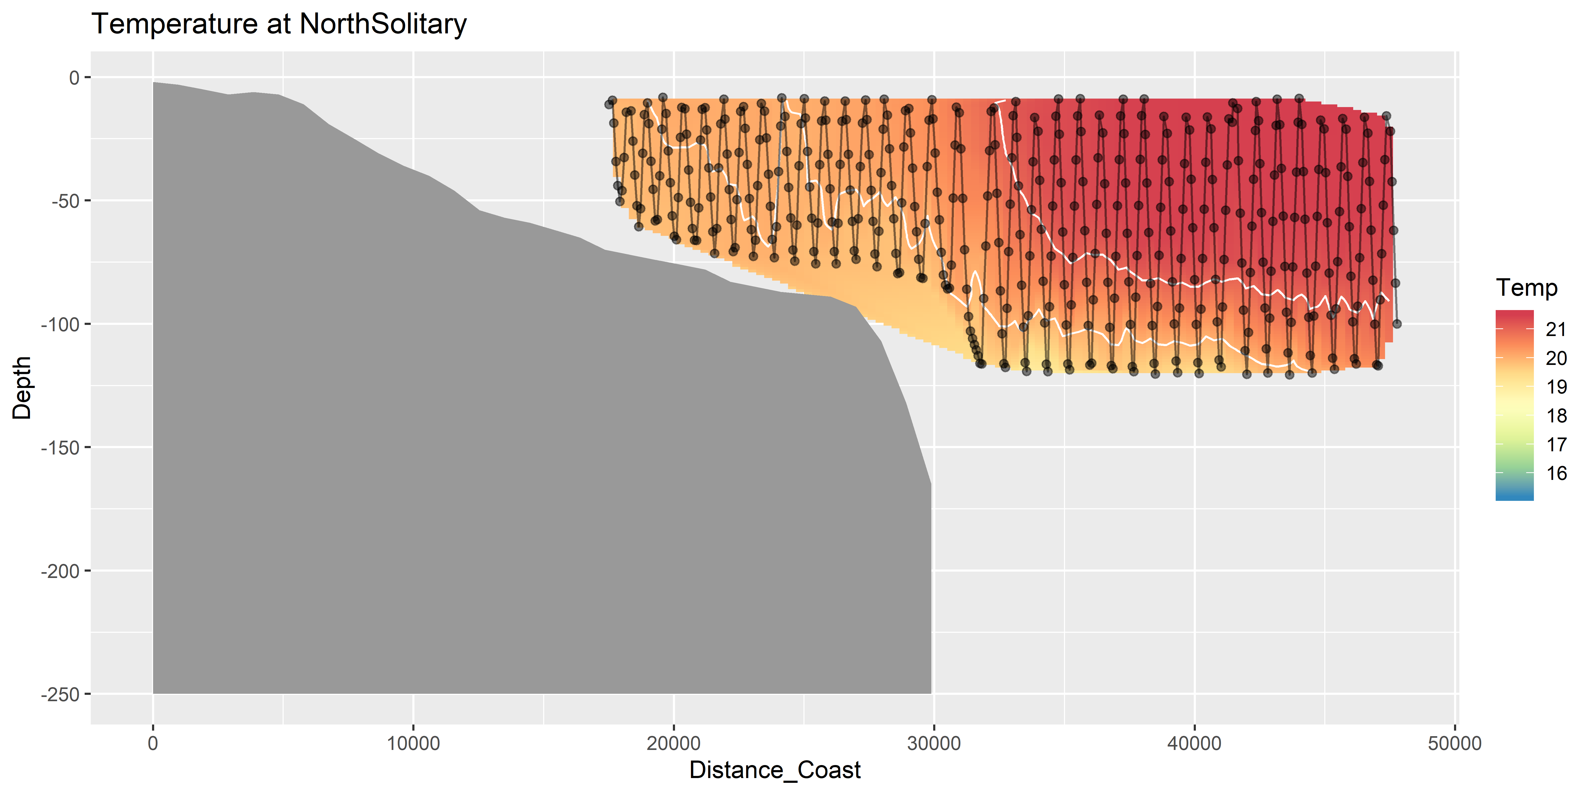
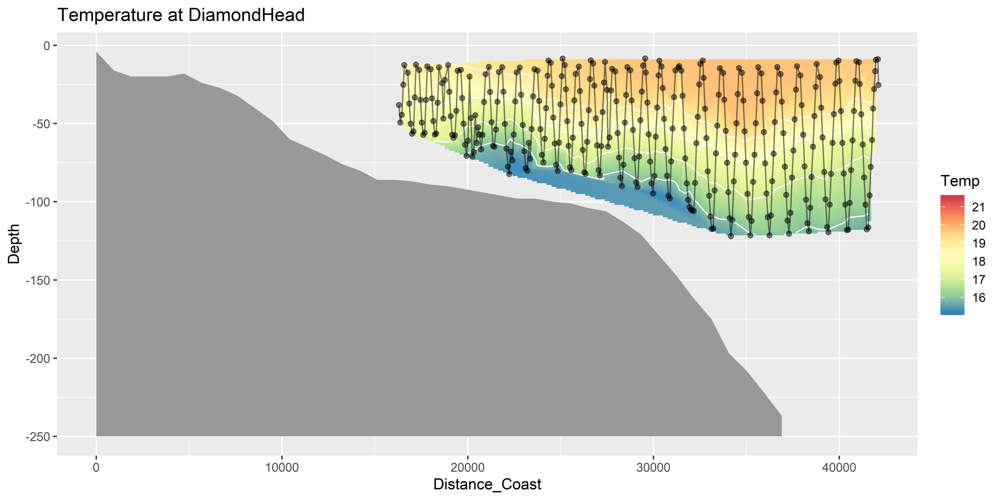
Temperature (seasoar)

Slide 28
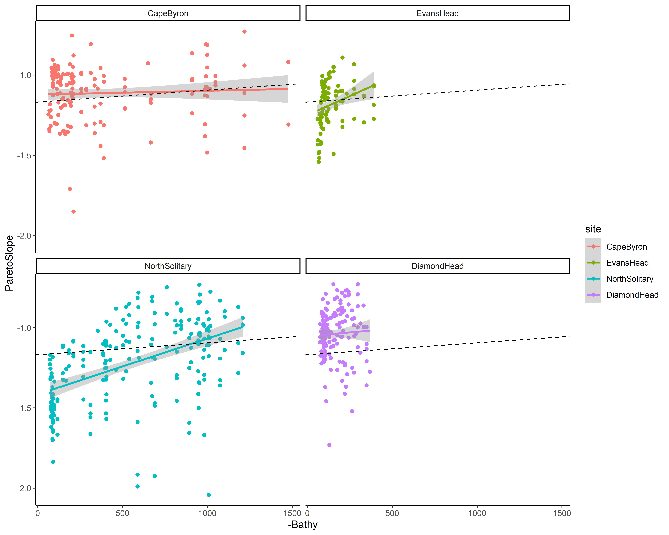
NBSS Pareto Slope
Dotted line is overall mean

Slide 29
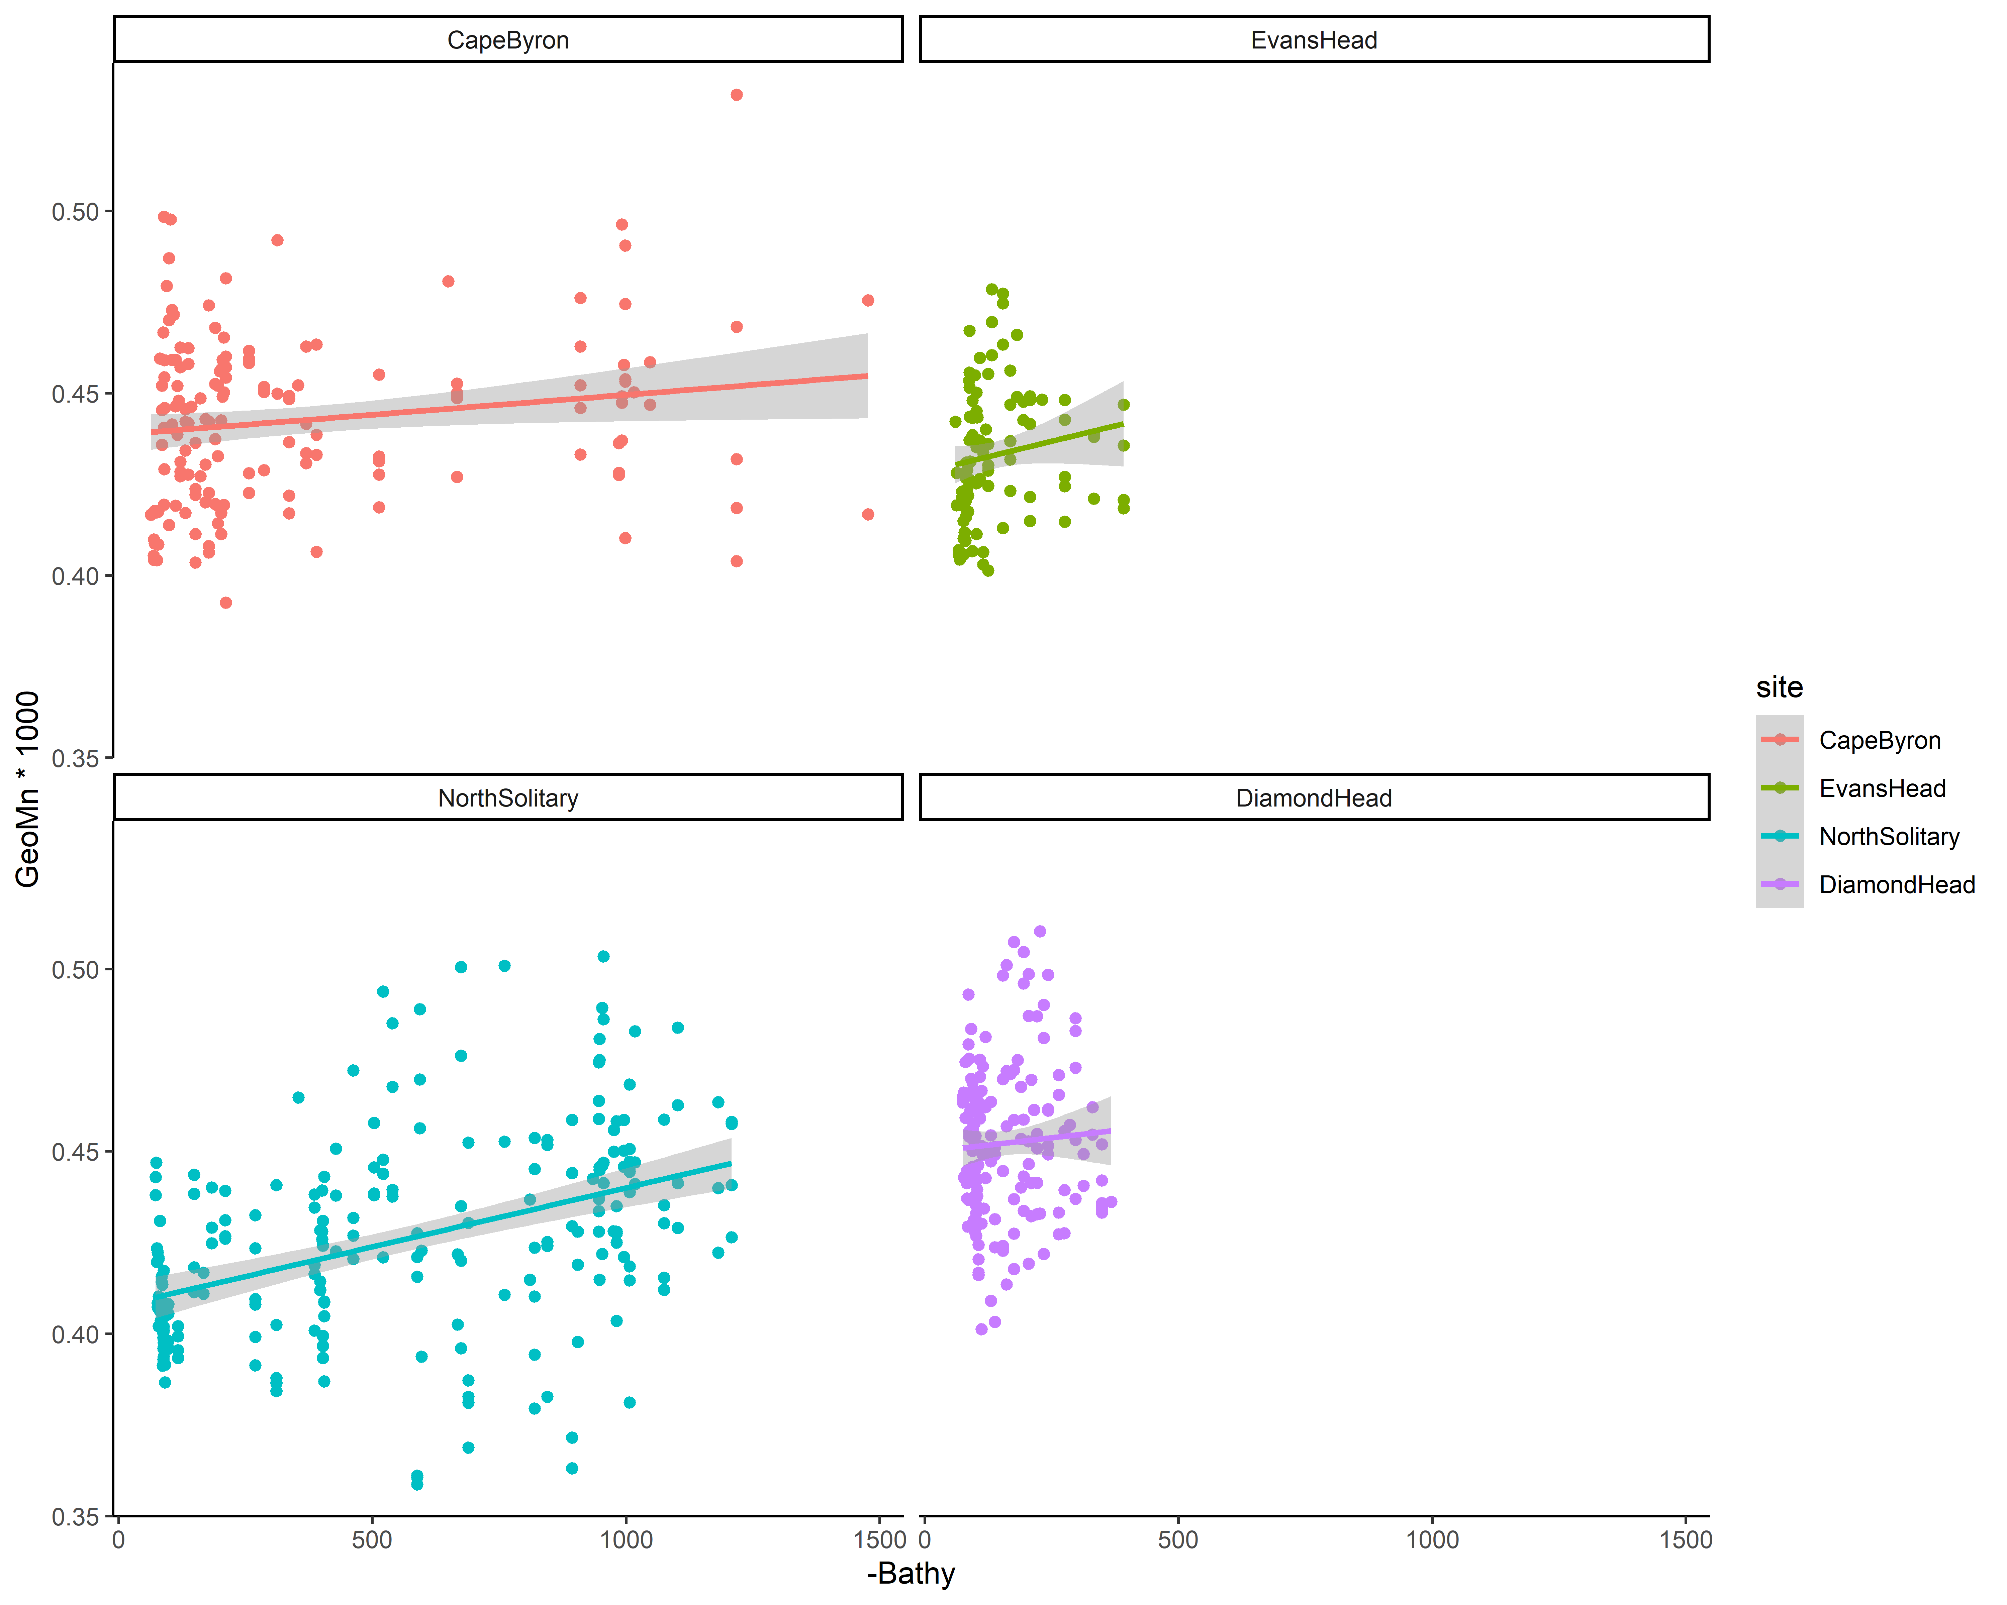
Size

Slide 30
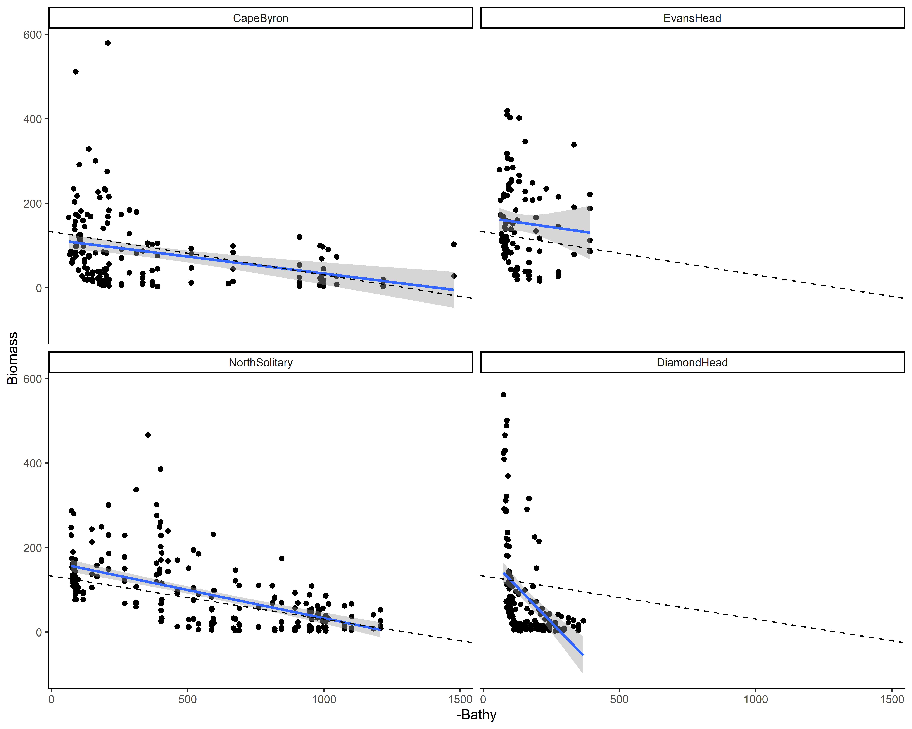
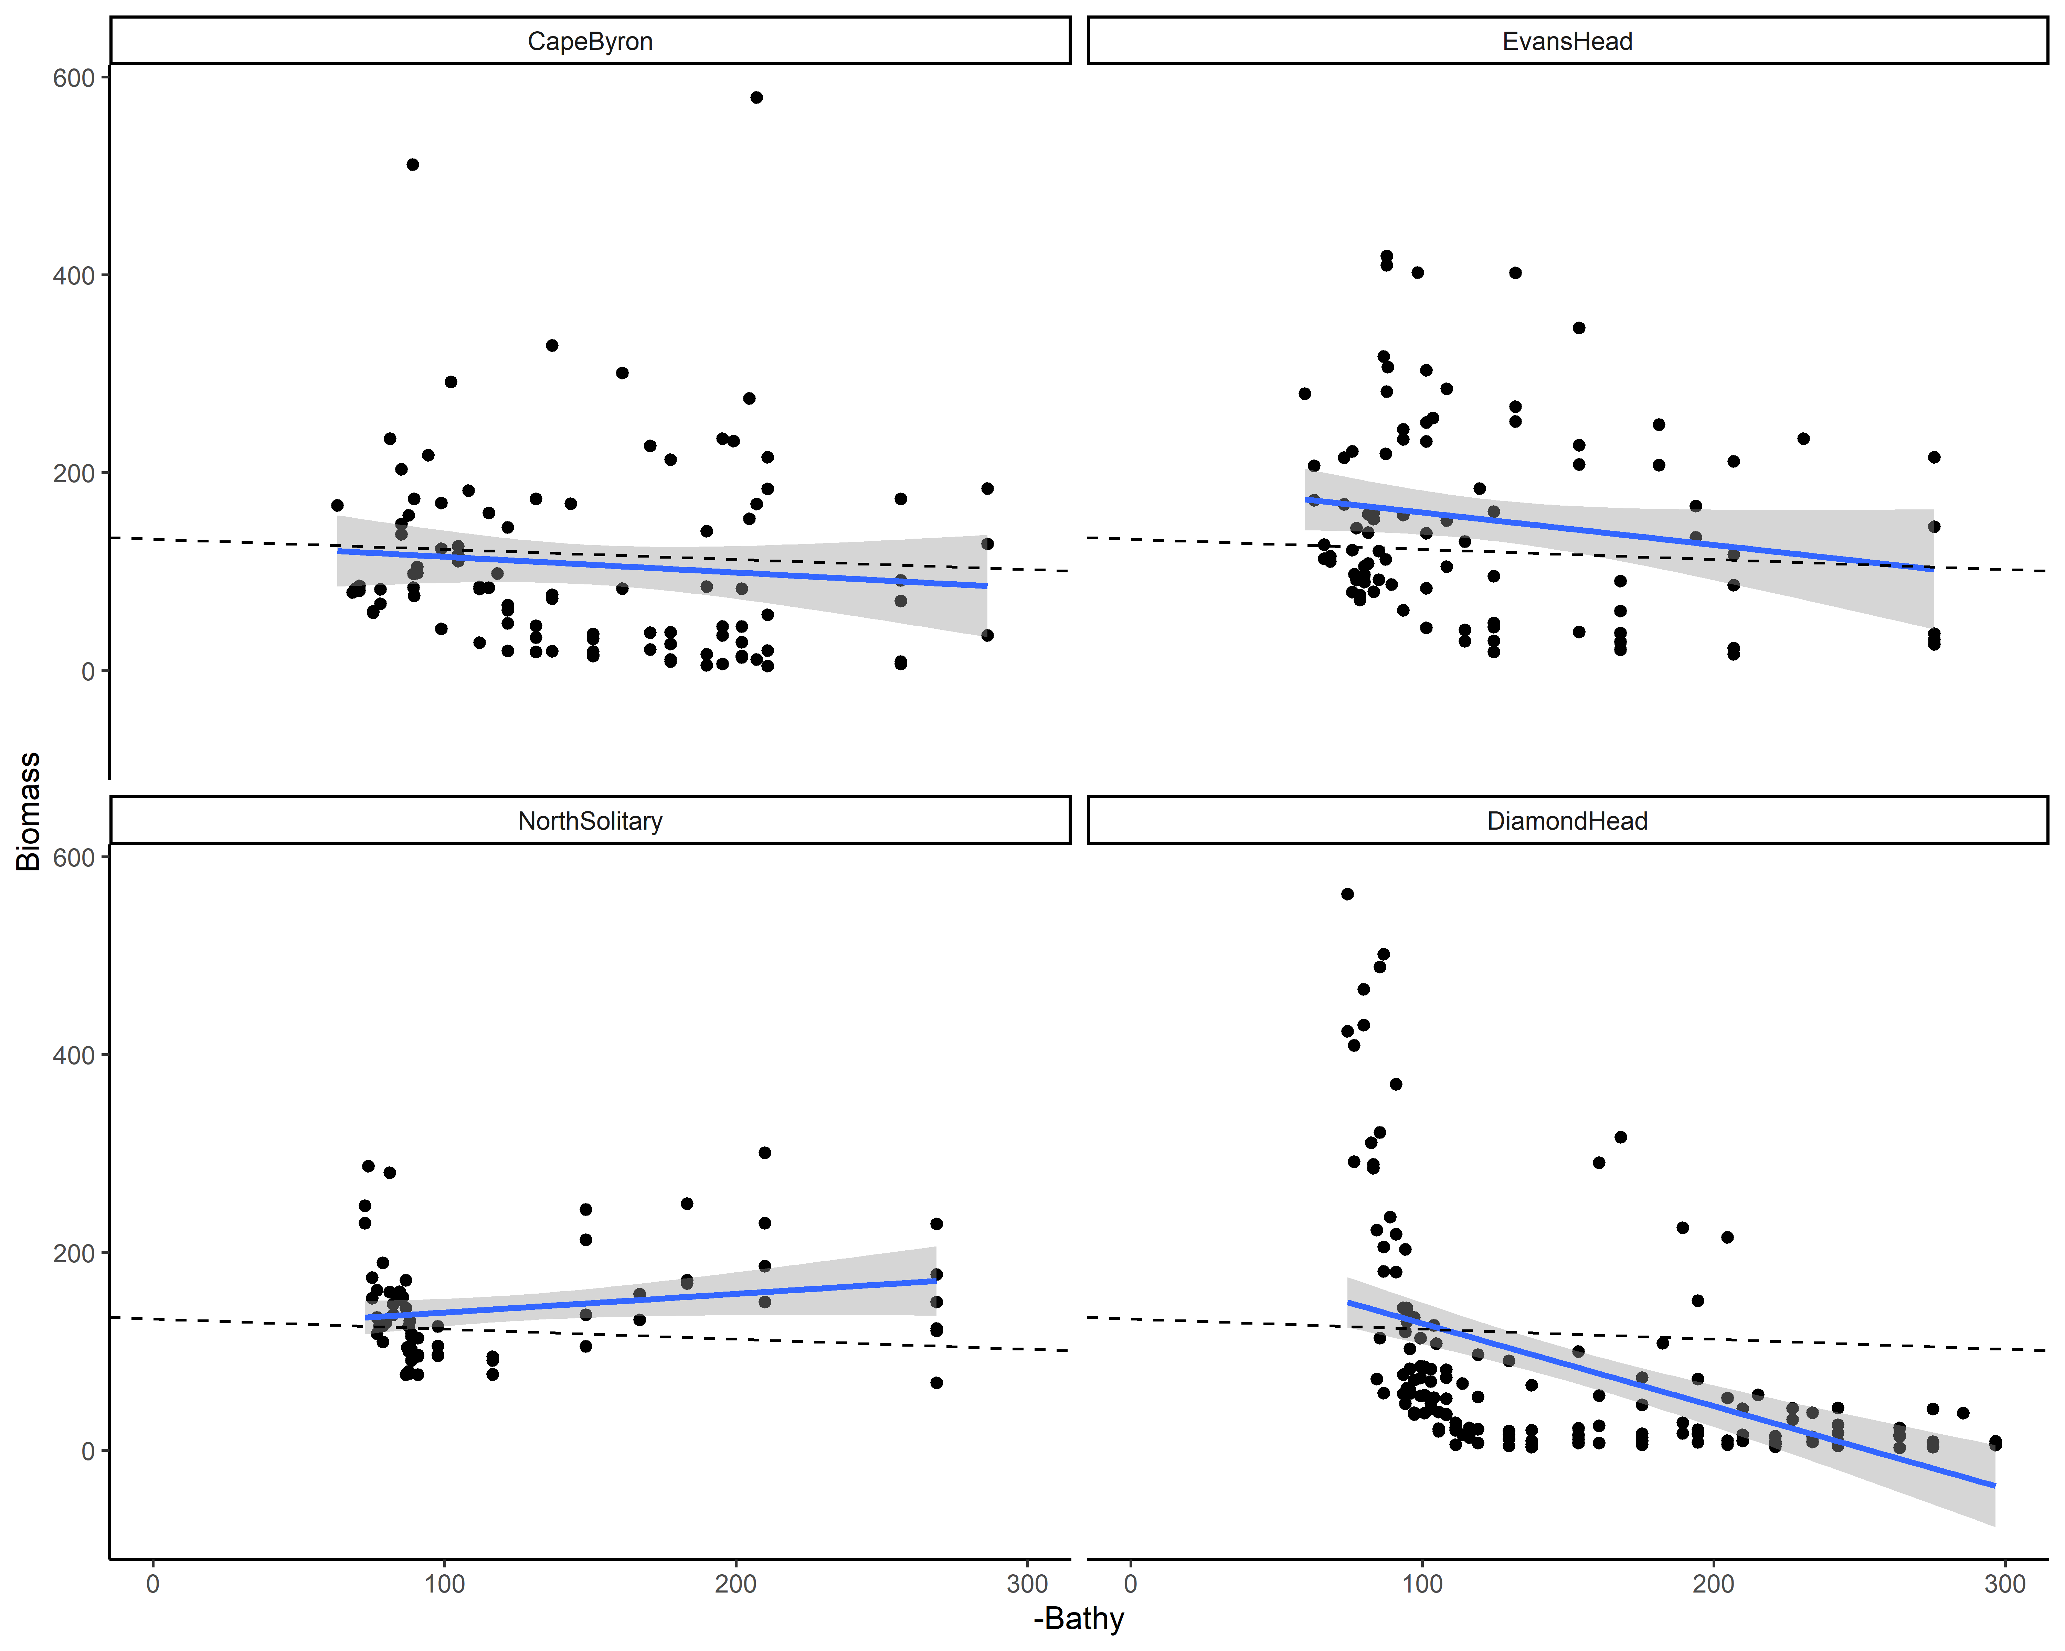
Biomass
Dotted line is overall mean
Full bathymetry x-axis
Reduced x-axis to 300m

Slide 31
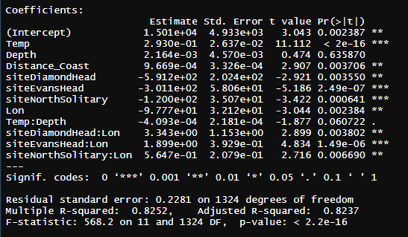
Zooplankton Biomass models
log10(Biomass) ~ Temp * Depth + Distance_Coast + site * Lon, data = mydataX)

Slide 32
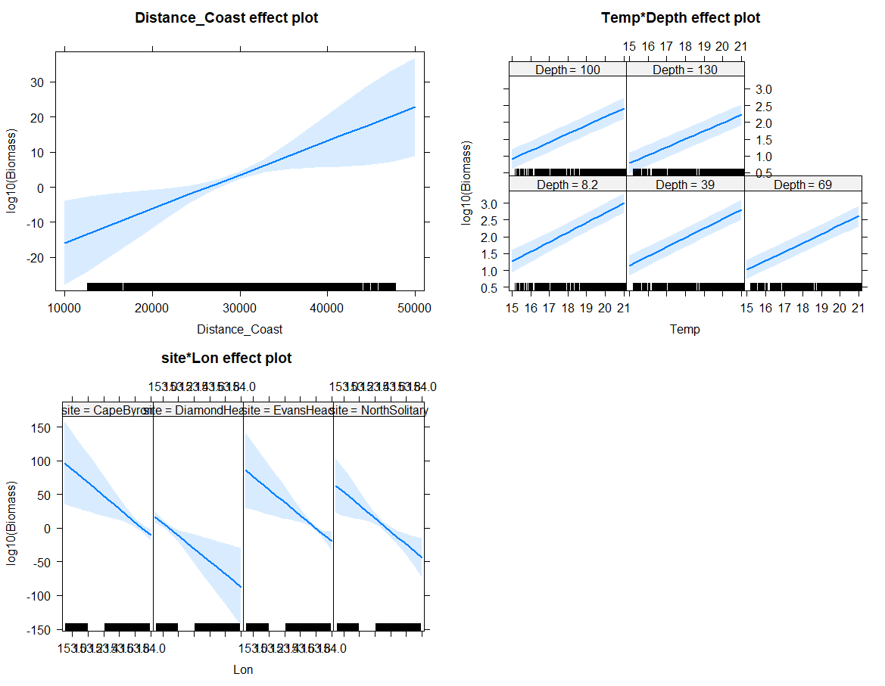

Slide 33
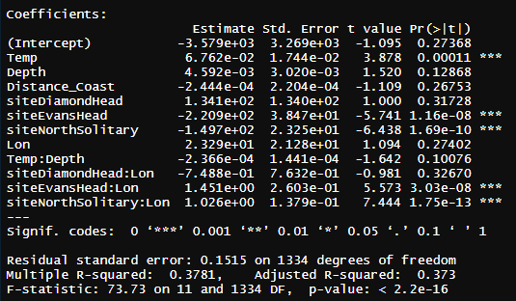
Pareto Slope Model
ParetoSlope ~ Temp * Depth + Distance_Coast + site * Lon

Slide 34
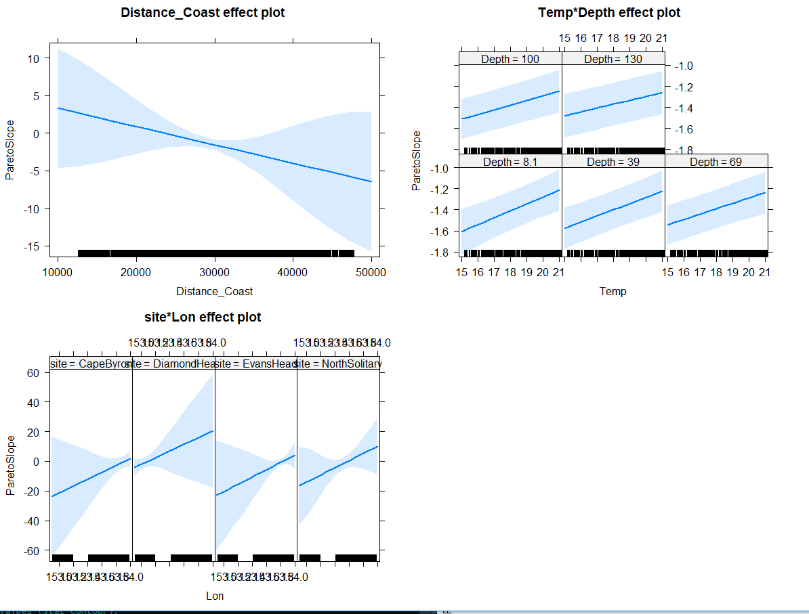

Slide 35
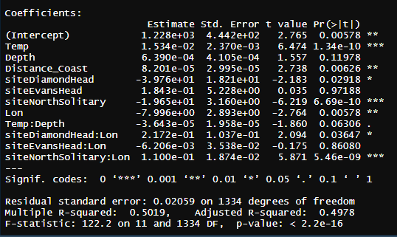
GeoMn Size
GeoMn*1000 ~ Temp * Depth + Distance_Coast + site * Lon, data = mydata

Slide 36
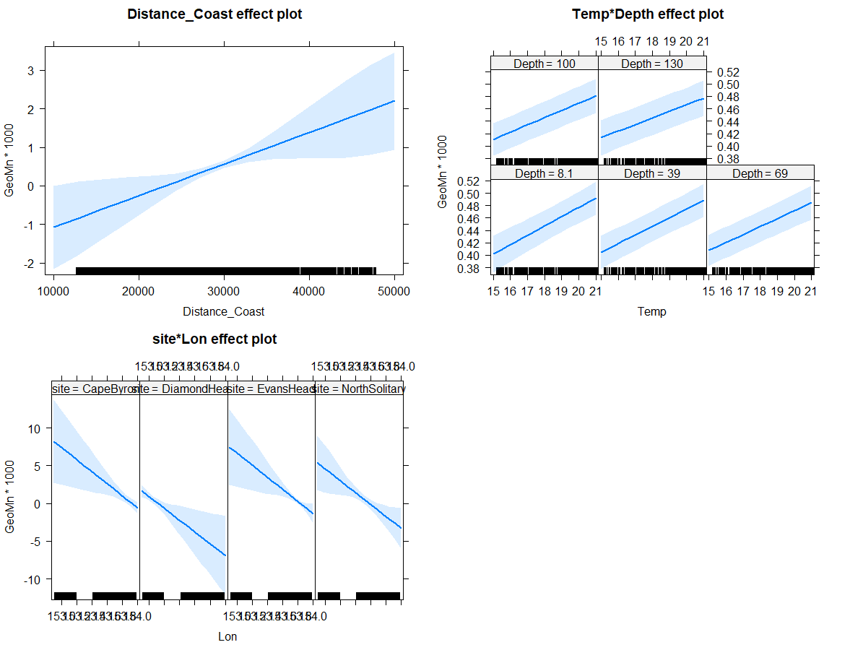

Slide 37
Larger context (not for today)
How typical are the observations seen in these transects?
Temp and Sal
Chl-a
IMOS NRS Moorings
Gliders
Satellite data

Slide 39
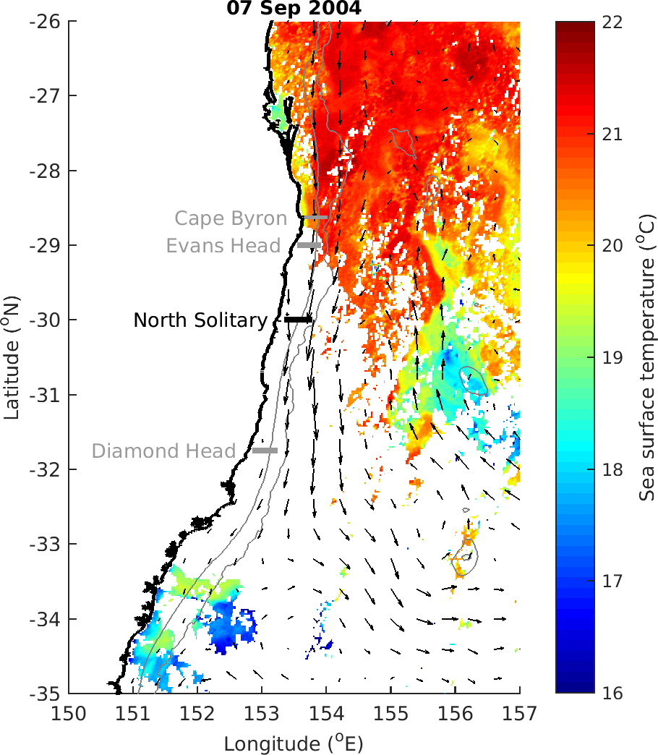

Slide 40
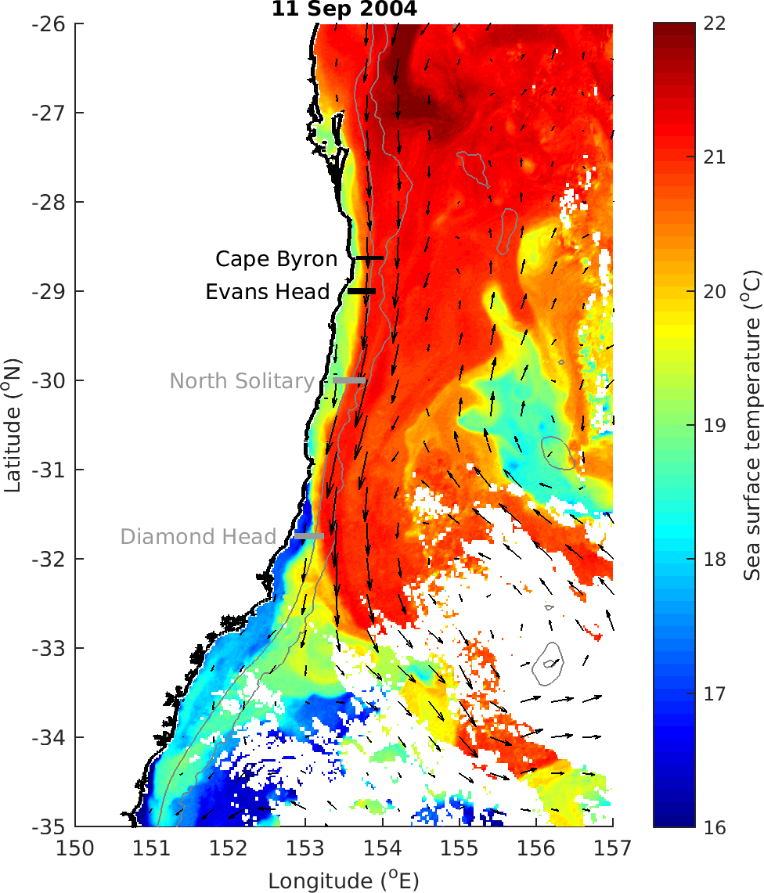

Slide 41

MODIS Chl_a

Slide 42
T-S Plot all depths (CTD)

Slide 43
TS Plot by log₁₀(Biomass)

Slide 44

TS Plot by log₁₀(Biomass) top 50m

Slide 45

TS Plot by log₁₀(Biomass) below 50m

Slide 46

TS plot by Depth

Slide 47

TS plot by Nitrate

Slide 48




U vectors
m s⁻¹
m s⁻¹
m s⁻¹
m s⁻¹

Slide 49
U vectors – shoreline rotated (m s⁻¹)

Slide 50




V vectors
m s⁻¹
m s⁻¹
m s⁻¹
m s⁻¹

Slide 51
V vectors – shoreline rotated (m s⁻¹)

Slide 52

ADCP Velocity on a map

Slide 53



Nitrate

Slide 54



Silicate

Slide 55



Oxygen

Slide 56



Oxygen utilisation (expected – observed)
um/kg
Positive = respiration (lower O₂ than expected)
Negative = photosynthesis / production
um/kg
um/kg

Slide 57



Salinity

Slide 58



Temperature
Deg C
Deg C
Deg C

Slide 59



Chl_a

Slide 60



Chl_a top 200m

Slide 61



Nitrate

Slide 62



Silicate

Slide 63



Oxygen

Slide 64



Oxygen utilisation (top 200m)
um/kg
Positive = respiration (lower O₂)
Negative = photosynthesis / production
um/kg
um/kg

Slide 65



Salinity

Slide 66



Temperature

Slide 67

Zooplankton Biomass temperature contours

Slide 68
Zooplankton Biomass

Slide 69




NBSS Slope

Slide 70
Pareto Slope

Slide 71

Abundance

Slide 72




Abundance

Slide 73
Geometric Mean Size

Slide 74
Wind Stress
DH
EH
CB

Slide 75

Modelling Zooplankton Biomass
Call: lm(formula = Biomass ~ Temp + Salt + Depth + site + Distance_Coast, data = mydata)
All variables significant except Salinity (P = 0.25)
Adj R² = 0.58
No autocorrelation taken in account ☹

Slide 76

Modelling Pareto Slope
Call: lm(formula = ParetoSlope ~ Temp + Salt + Depth + site + Distance_Coast, data = mydata)
All variables significant except Depth (P = 0.25)
Adj R² = 0.33
No autocorrelation taken in account ☹

Slide 77
Expectations
Areas of upwelling should have higher nutrients and plankton abundance
Areas offshore (open ocean water) should have slopes closer to -1
Southern sites should have higher biomass (colder water influence)

Slide 78
Patterns
Inshore North Solitary shows some upwelling + higher nutrients + biomass
North Solitary, Evans Head and Cape Byron have high surface biomass offshore (but not abundance?) – this is weird Data error
Abundance (and biomass) increases towards the shelf (I think this is common but relatively unpublished?)

